Slide 1
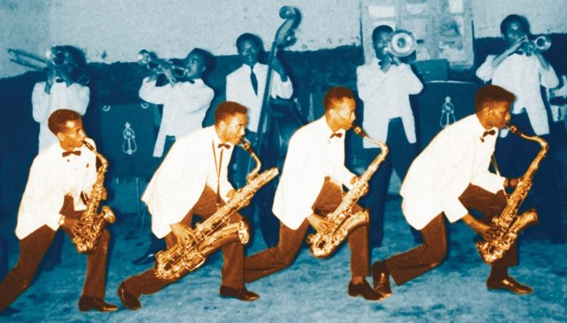

Ethiopian jazz
DER DEUTSCH-ÄTHIOPISCHEr VEREIN E.V. LÄDT EIN ZUM JÄHRLICHEN SEMINAR: 30 JAHRE DÄV
Ilaria zorzan
21 March 2025

Slide 2
Ethiopian Music employs a unique modal system called qəñət (ቅኝት), which is penatatonic.
Scales are placed into 4 main categories:
Tǝzǝtā (ትዝታ) is often associated with nostalgia and longing
Bāti (ባቲ) is characterized by a bright, joyful sound.
ʾAmbāssal (አምባሰል) evokes a more somber mood.
Ančihoye
(አንቺ ሆዬ)
Notes:
Penatatonic: long intervals between some notes.

Slide 3
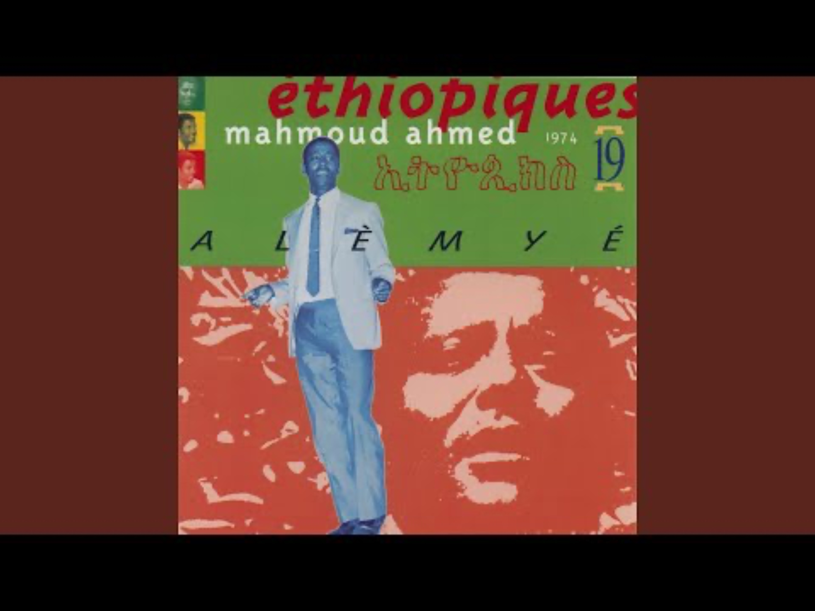
Tǝzǝtā (ትዝታ)
Tizita Major
C͜ D͜ E ͡ ͜ G͜ A͜ ͡ C
Tizita Minor
C͜ D͡ Eb͜ ͜ G͡ A͜ ͡ C

Slide 4
Ethiopian Music employs a unique modal system called qəñət (ቅኝት), which is penatatonic.
Scales are placed into 4 main categories:
Tǝzǝtā (ትዝታ) is often associated with nostalgia and longing
Bāti (ባቲ) is characterized by a bright, joyful sound.
ʾAmbāssal (አምባሰል) evokes a more somber mood.
Ančihoye
(አንቺ ሆዬ)
Notes:
Penatatonic: long intervals between some notes.

Slide 5


Bāti (ባቲ)
Bāti Major
C ͜ ͡ E ͡ F͜ G͜ ͜ B͡ C
Bāti Minor
C͜ ͡ Eb͜ F͜ G͜ ͡ Bb͜ C

Slide 6
Ethiopian Music employs a unique modal system called qəñət (ቅኝት), which is penatatonic.
Scales are placed into 4 main categories:
Tǝzǝtā (ትዝታ) is often associated with nostalgia and longing
Bāti (ባቲ) is characterized by a bright, joyful sound.
ʾAmbāssal (አምባሰል) evokes a more somber mood.
Ančihoye
(አንቺ ሆዬ)
Notes:
Penatatonic: long intervals between some notes.

Slide 7
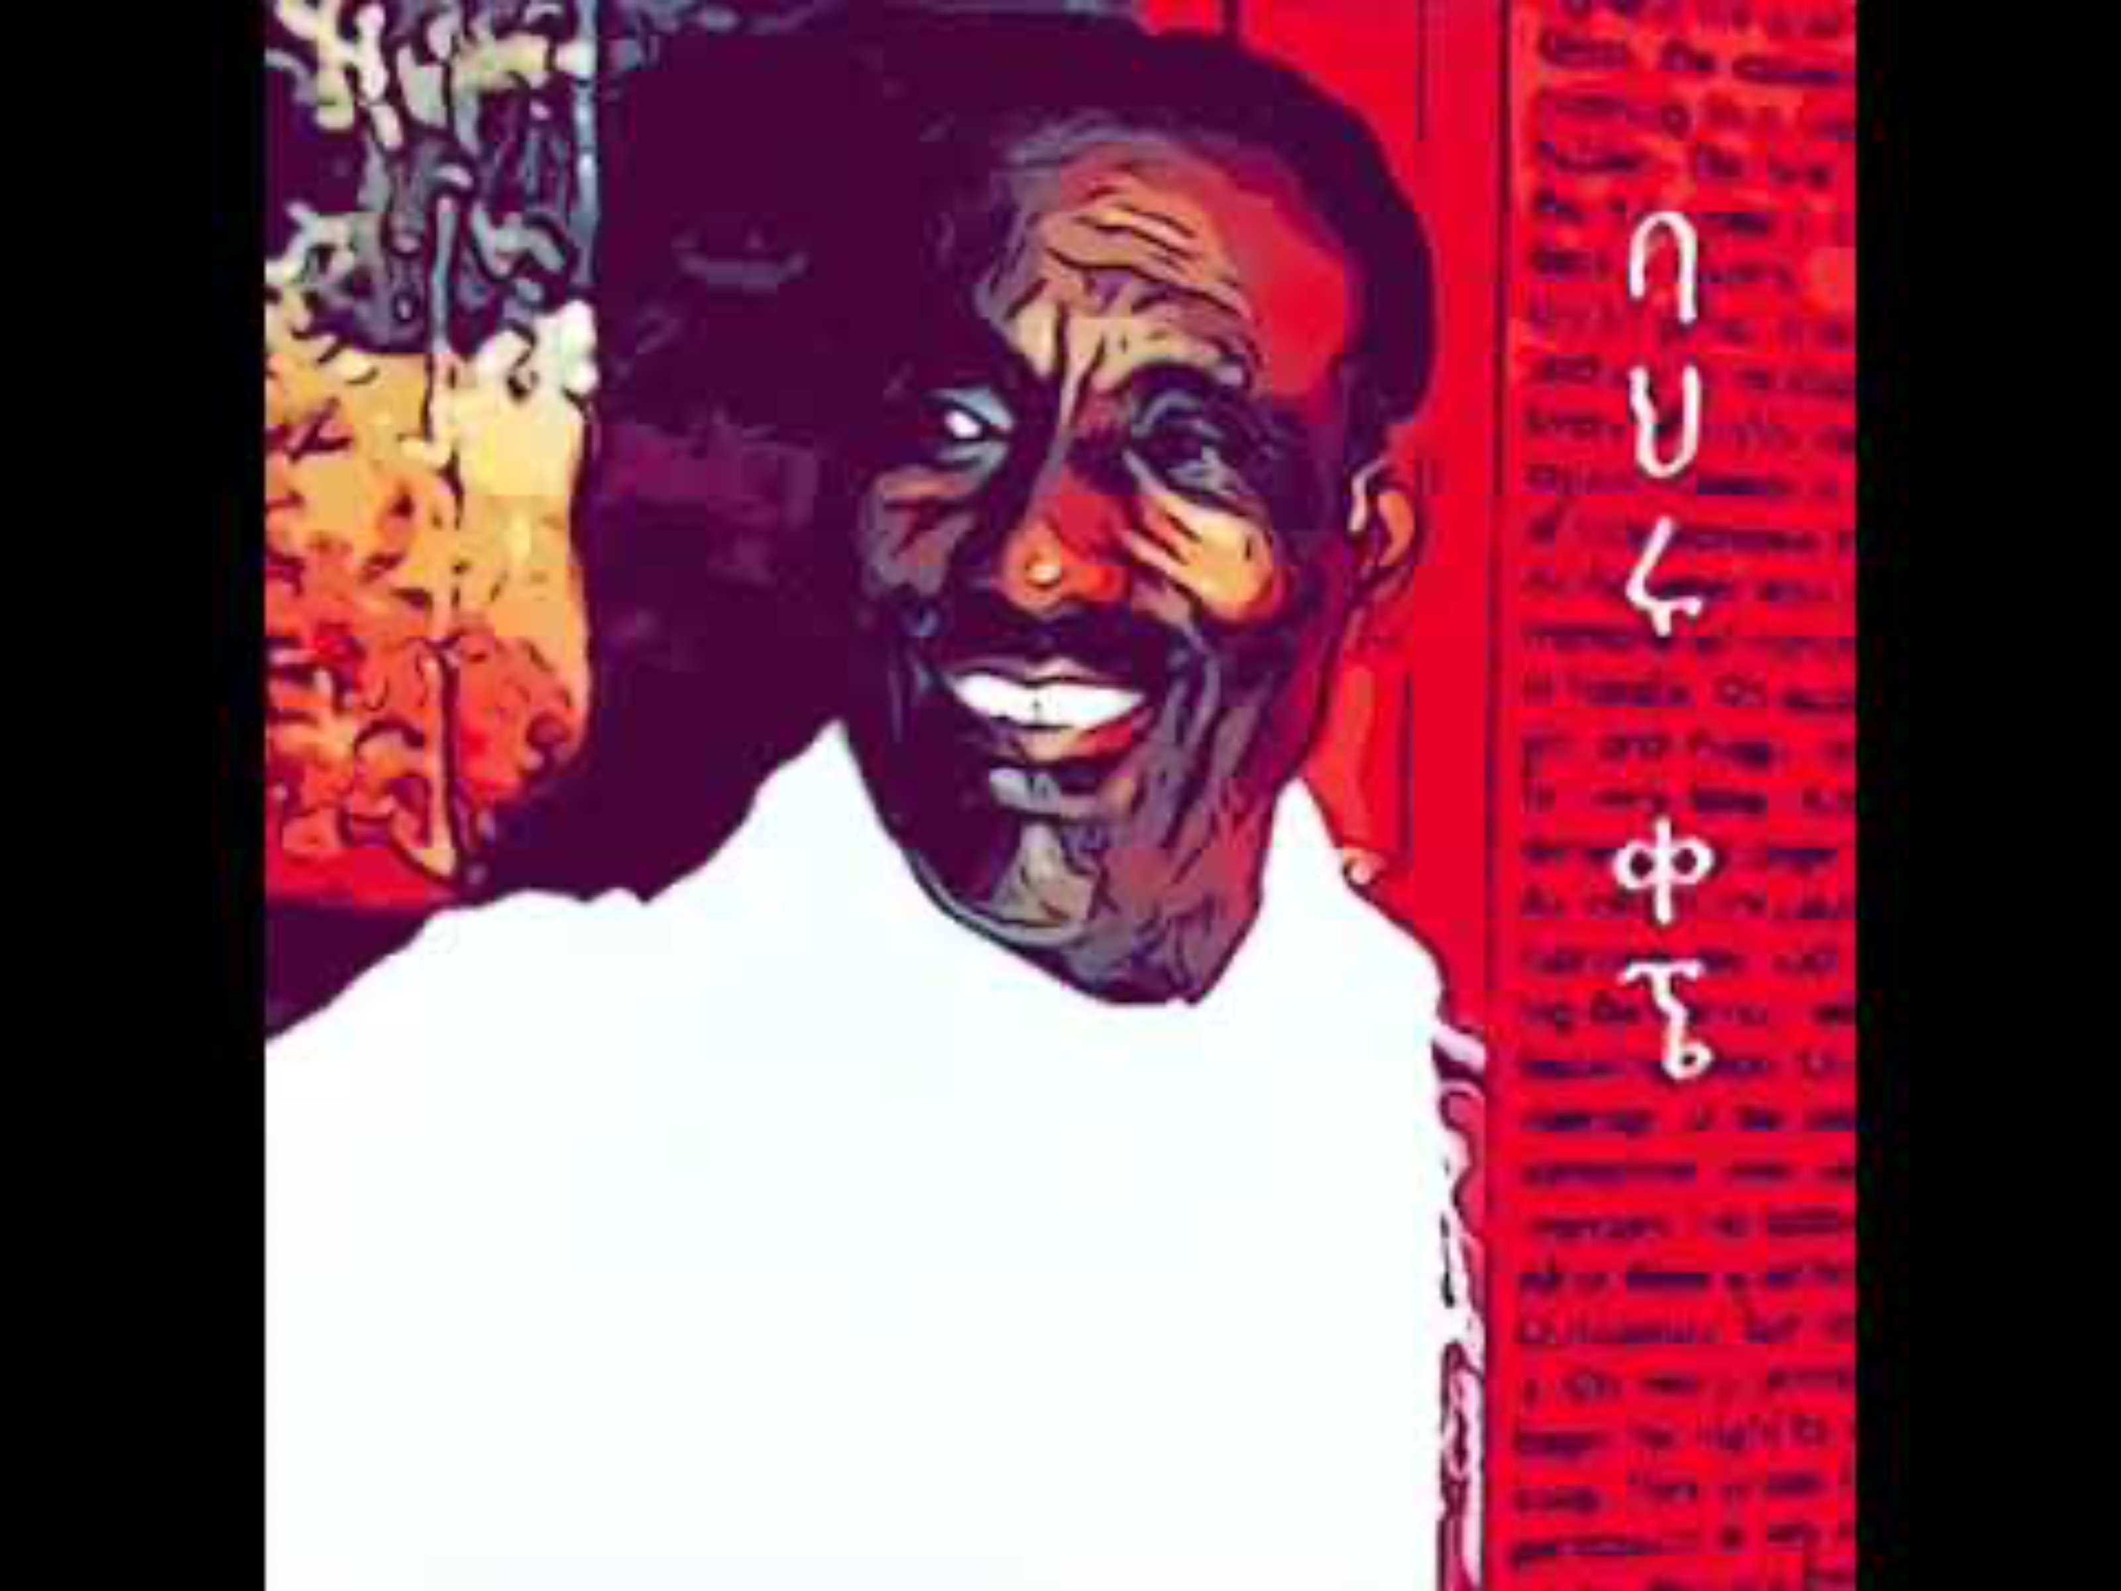
ʾAmbāssal (አምባሳል)
Ambassel 1
C͡ Db͡ ͜ ͡ F ͜ G͡ Ab͡ ͜ ͡ C
Ambassel 2
C͜ D͜ ͡ F͜ G͜ A͜ ͡ C

Slide 8
Ethiopian Music employs a unique modal system called qəñət (ቅኝት), which is penatatonic.
Scales are placed into 4 main categories:
Tǝzǝtā (ትዝታ) is often associated with nostalgia and longing
Bāti (ባቲ) is characterized by a bright, joyful sound.
ʾAmbāssal (አምባሰል) evokes a more somber mood.
Ančihoye
(አንቺ ሆዬ)
Notes:
Penatatonic: long intervals between some notes.

Slide 9
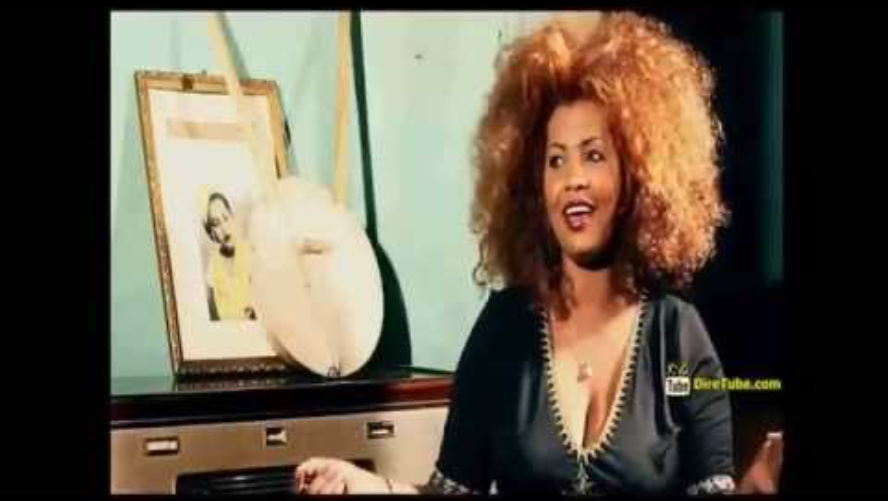
Ančihoye (አንቺሆዬ)
͡ Db͡ ͜ ͡ F͡ Gb͡ ͜ A͜ ͡ C

Slide 10
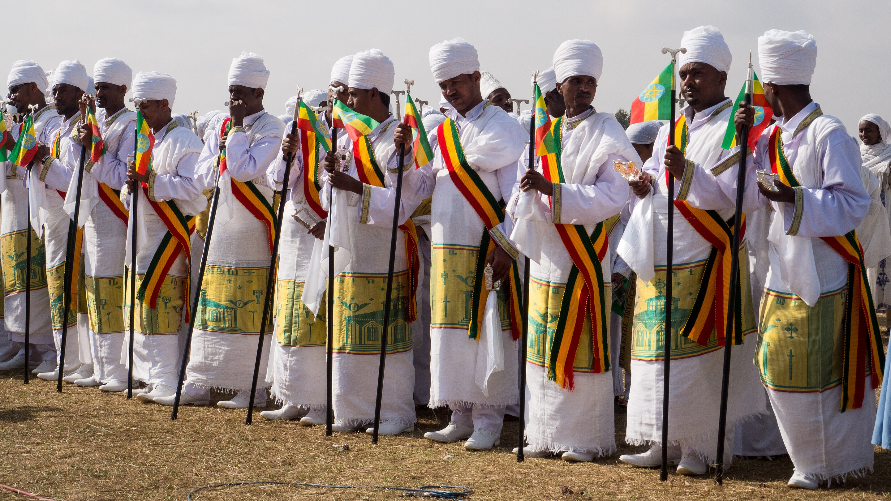
Church-related music is called zamā (ዘማ).
Notes:
https://www.youtube.com/watch?v=fDPXtIsjeD0

Slide 11
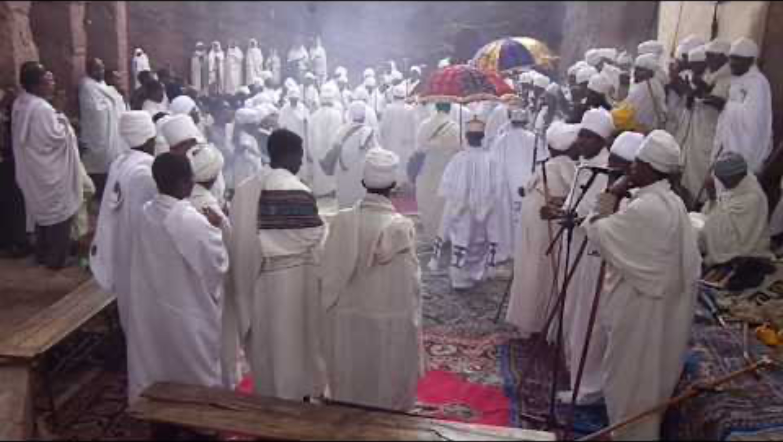
Notes:
performance of the Ethiopian Christian liturgy (Qéddase)

Slide 12
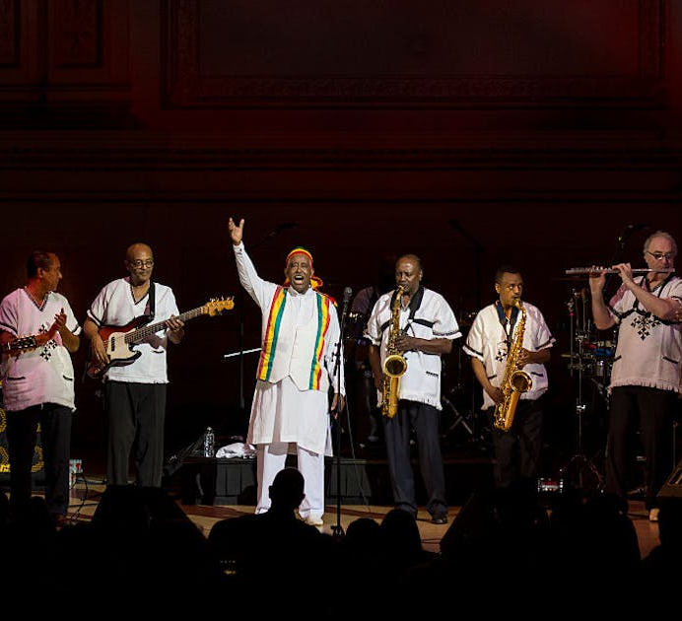
Purpose: cultural events, entertainment, social gatherings, and cultural expression.
Themes: love, everyday life, social issues, and celebrations.
Instruments: traditional instruments may be used, but there is also a greater incorporation of modern instruments.
Style: Varies widely, including folk, pop, afro-funk, and hip-hop influences.
Secular music is called Zäfän (ዘፈን).
Notes:
https://www.youtube.com/watch?v=fDPXtIsjeD0

Slide 13
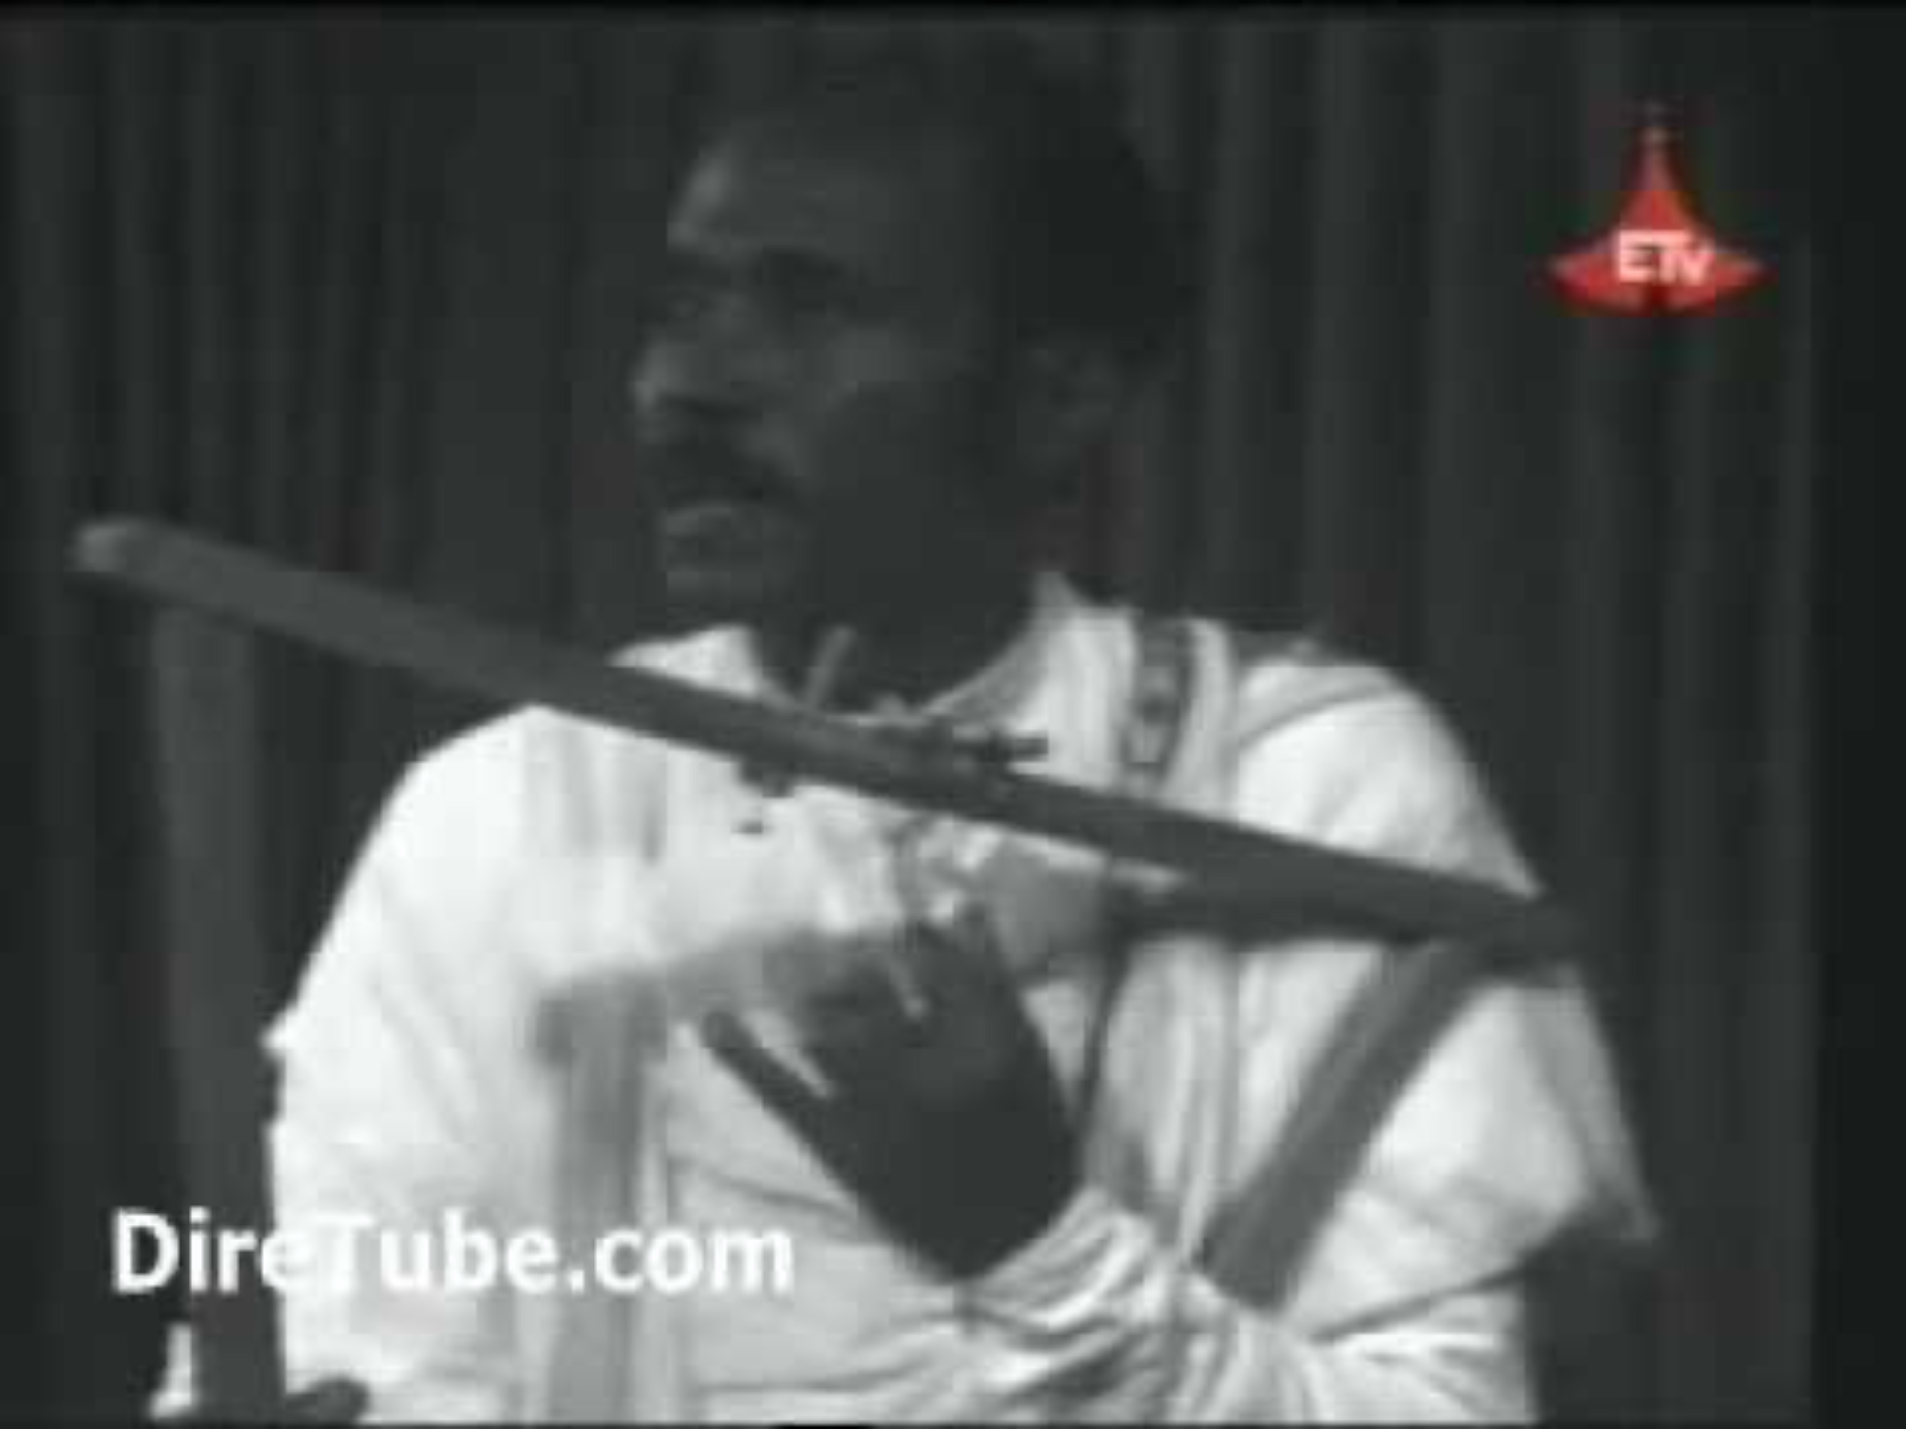
Alemayehu Fanta
Notes:
krar

Slide 14
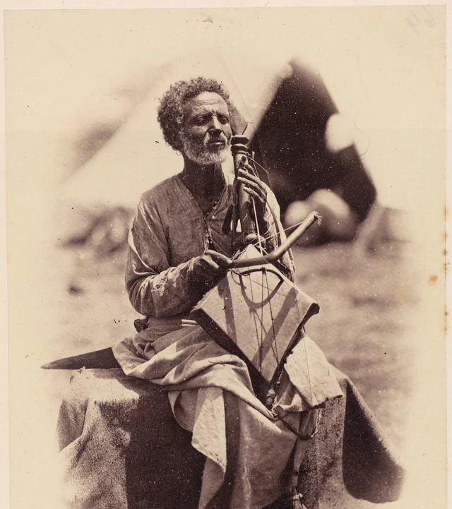
The Azmari (አዝማሪ) is known for their ability to improvise verses on the spot.

Slide 15
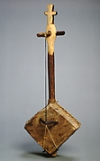
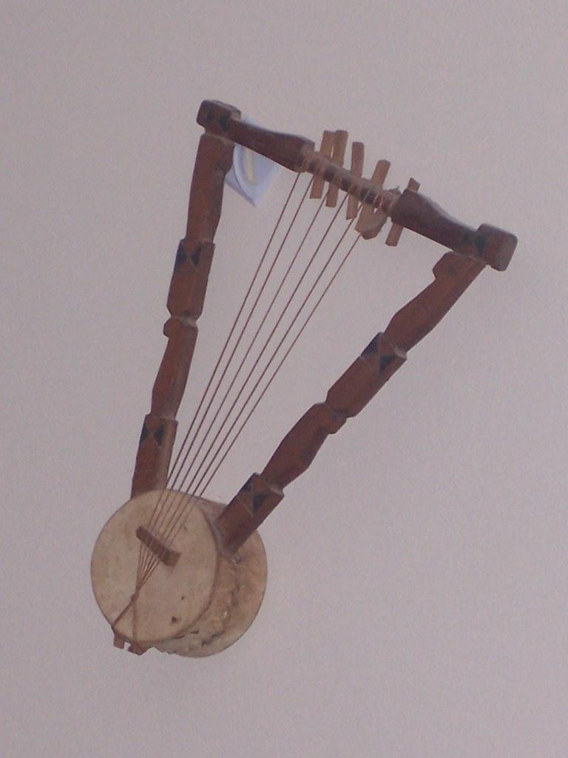
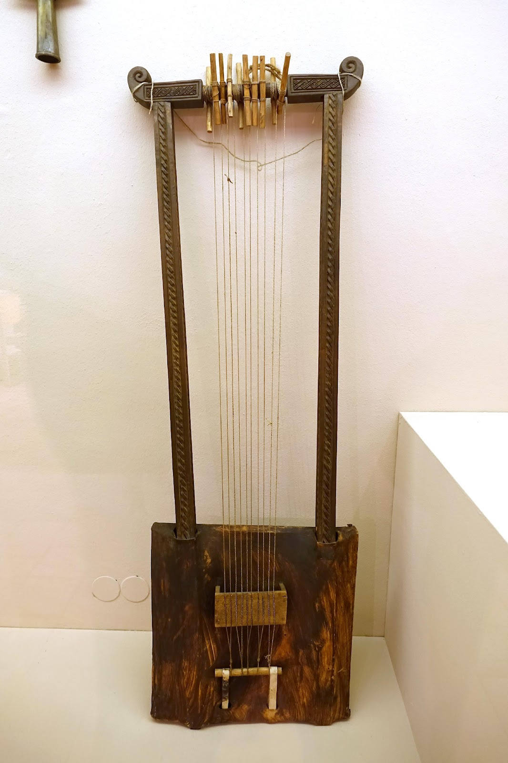
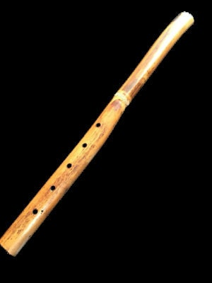
ETHIOPIAN TRADITIONAL INSTRUMENTS
Masenqo (ማሲንቆ) a single-stringed bowed lute
Krar (ክራር), a six-stringed, bowl-shaped lyre
Begena (በገና), ten-stringed box-lyre
Washint (ዋሽንት), end-blown wooden flute

Slide 16
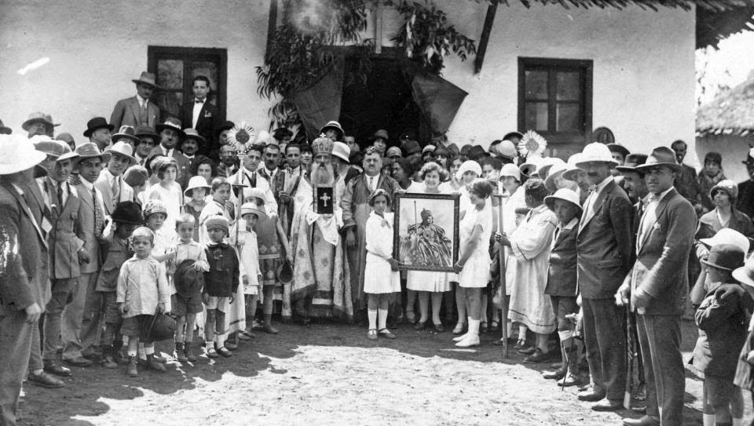
HISTORICAL CONTEXT
The origins of Ethiopian Jazz can be traced back to the Armenian community in Ethiopia.

Slide 17
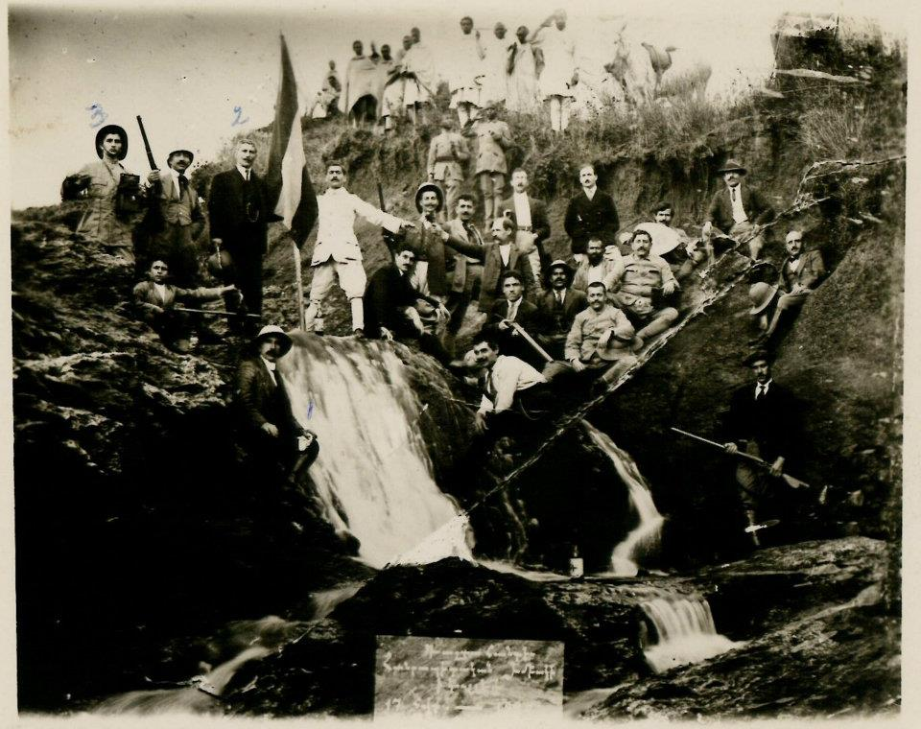
The Armenian community has played a great role in Ethiopian culture, particularly in the capital, Addis Ababa, where a significant Armenian diaspora has existed for more than a century.
Members of the Armenian Revolutionary Federation of Addis Ababa, Ethiopia, holding the Ethiopian flag in 1910

Slide 18
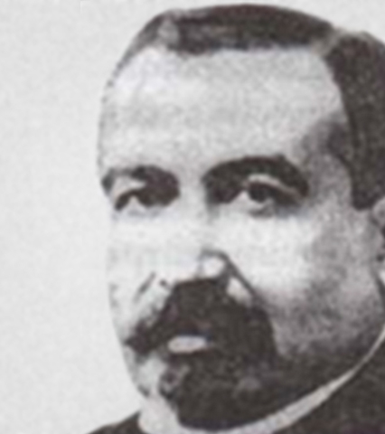
Kevork Nalbandian
(1840-1916)
Director of the orphan choir known as the ʾArbā Lǝǧǧoč or “40 children” (orphans).

Slide 19
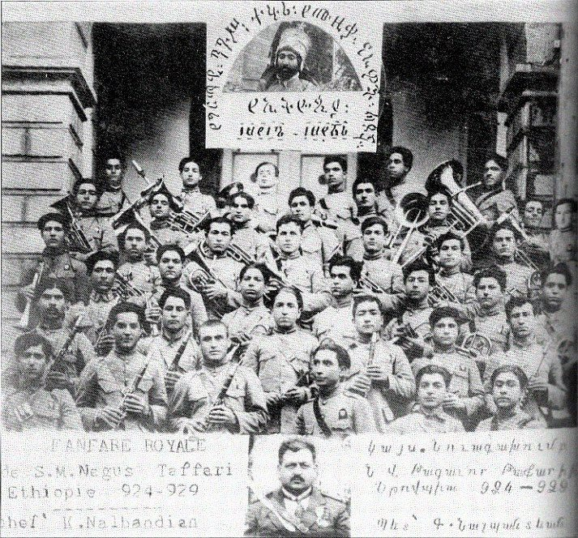

Slide 20
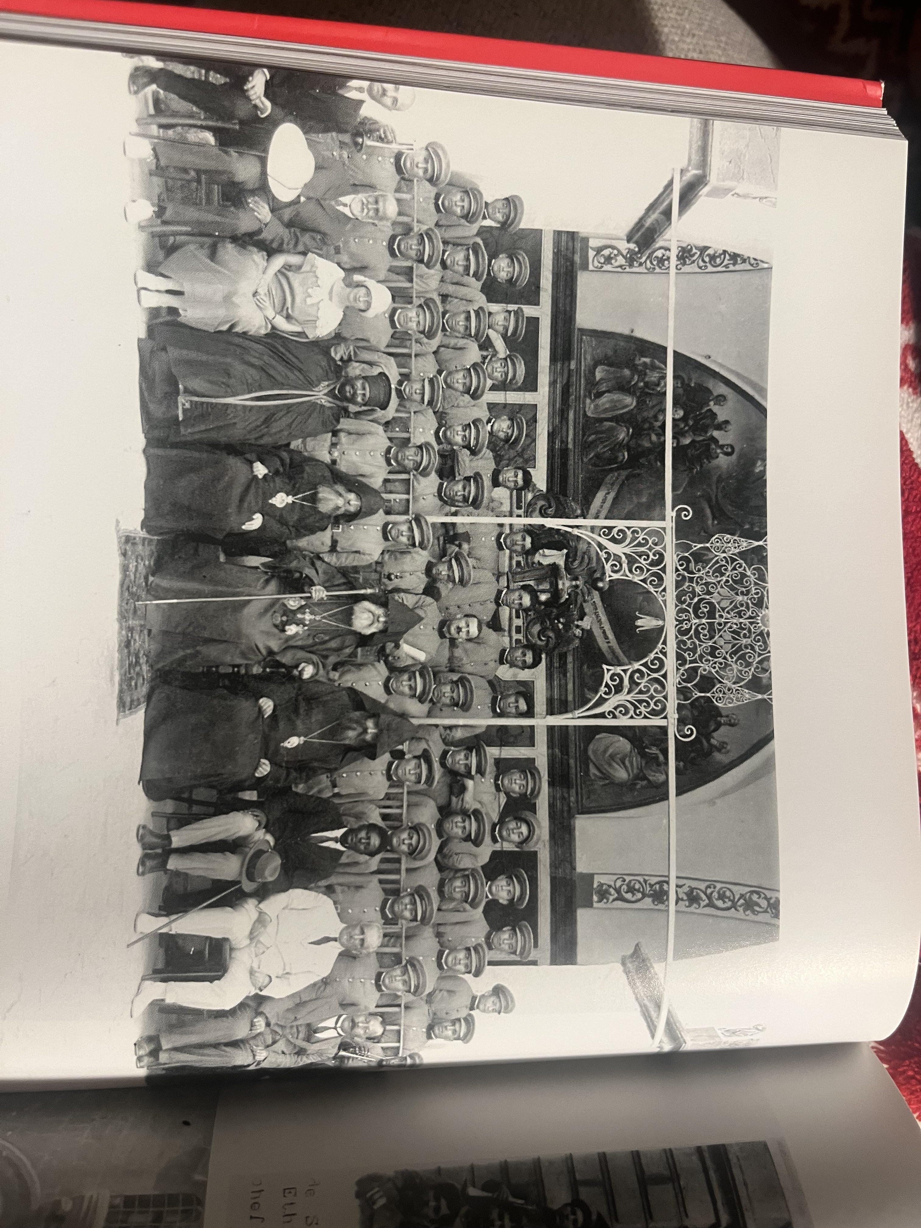

Slide 21

ኢትዮጵያ ሆይ ደስ ይበልሽ - Ethiopia, Be Happy
Ethiopia, be happy
thanks to the power of God and your ruler.
Your brave citizens are unanimous;
your freedom will never be touched,
As your mountains are defiant
and your natives do not fear any enemy.
Long live our victorious ruler
to the glory of our country
Notes:
Ityoṗya hoy des yebälesh

Slide 22
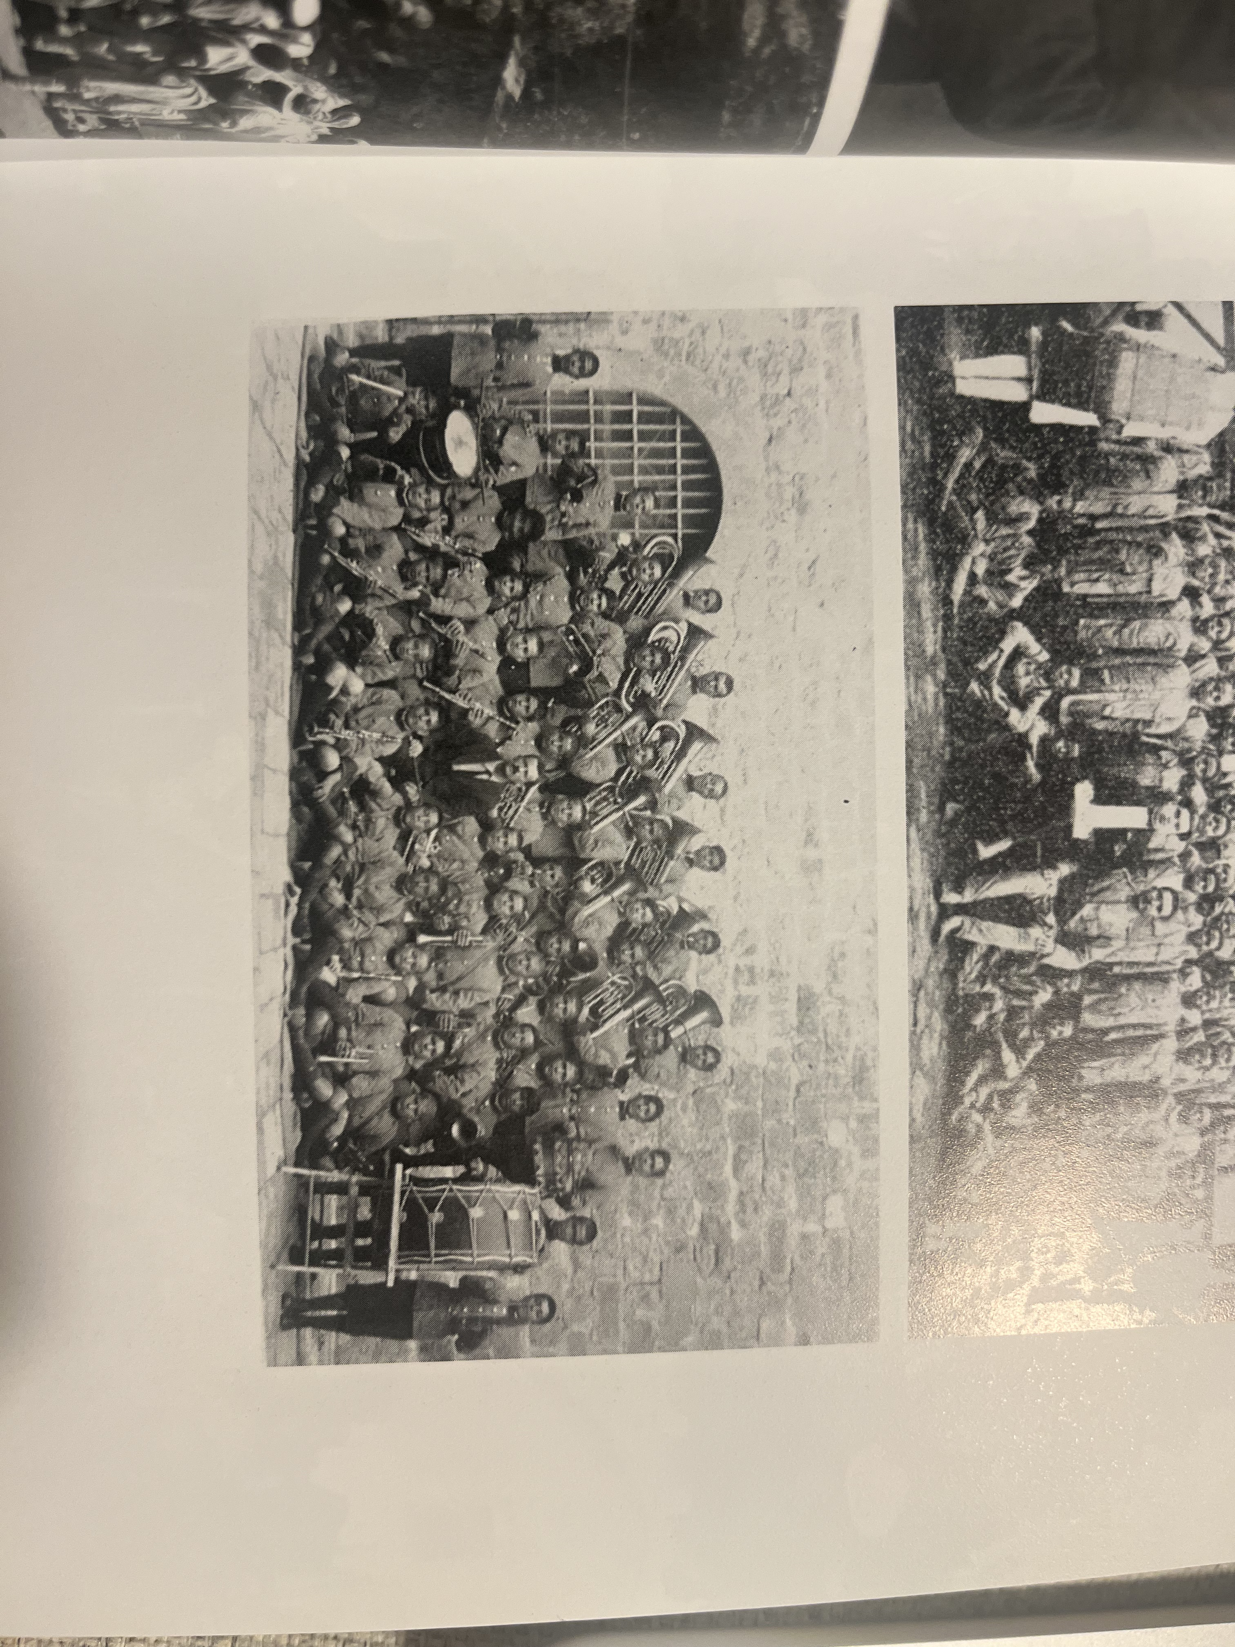
The ʾArbā Lǝǧǧoč performed the anthem for the first time in public during Śǝlassie’s coronation as emperor on November 2nd, 1930.

Slide 23
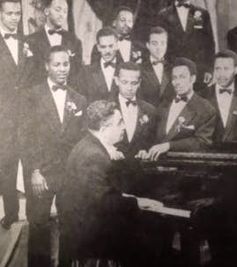
NERSES Nalbandian
(1915-1977)
He worked as a music teacher and choirmaster at the Armenian Orthodox Church in Syria before moving to Ethiopia in 1938.
Music director of the Haila Selassie Theater in 1956.

Slide 24
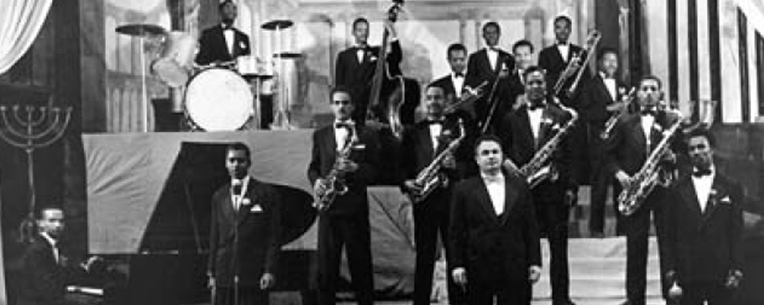
Nerses set the basis for the evolution of Ehiopian-jazz.

Slide 25
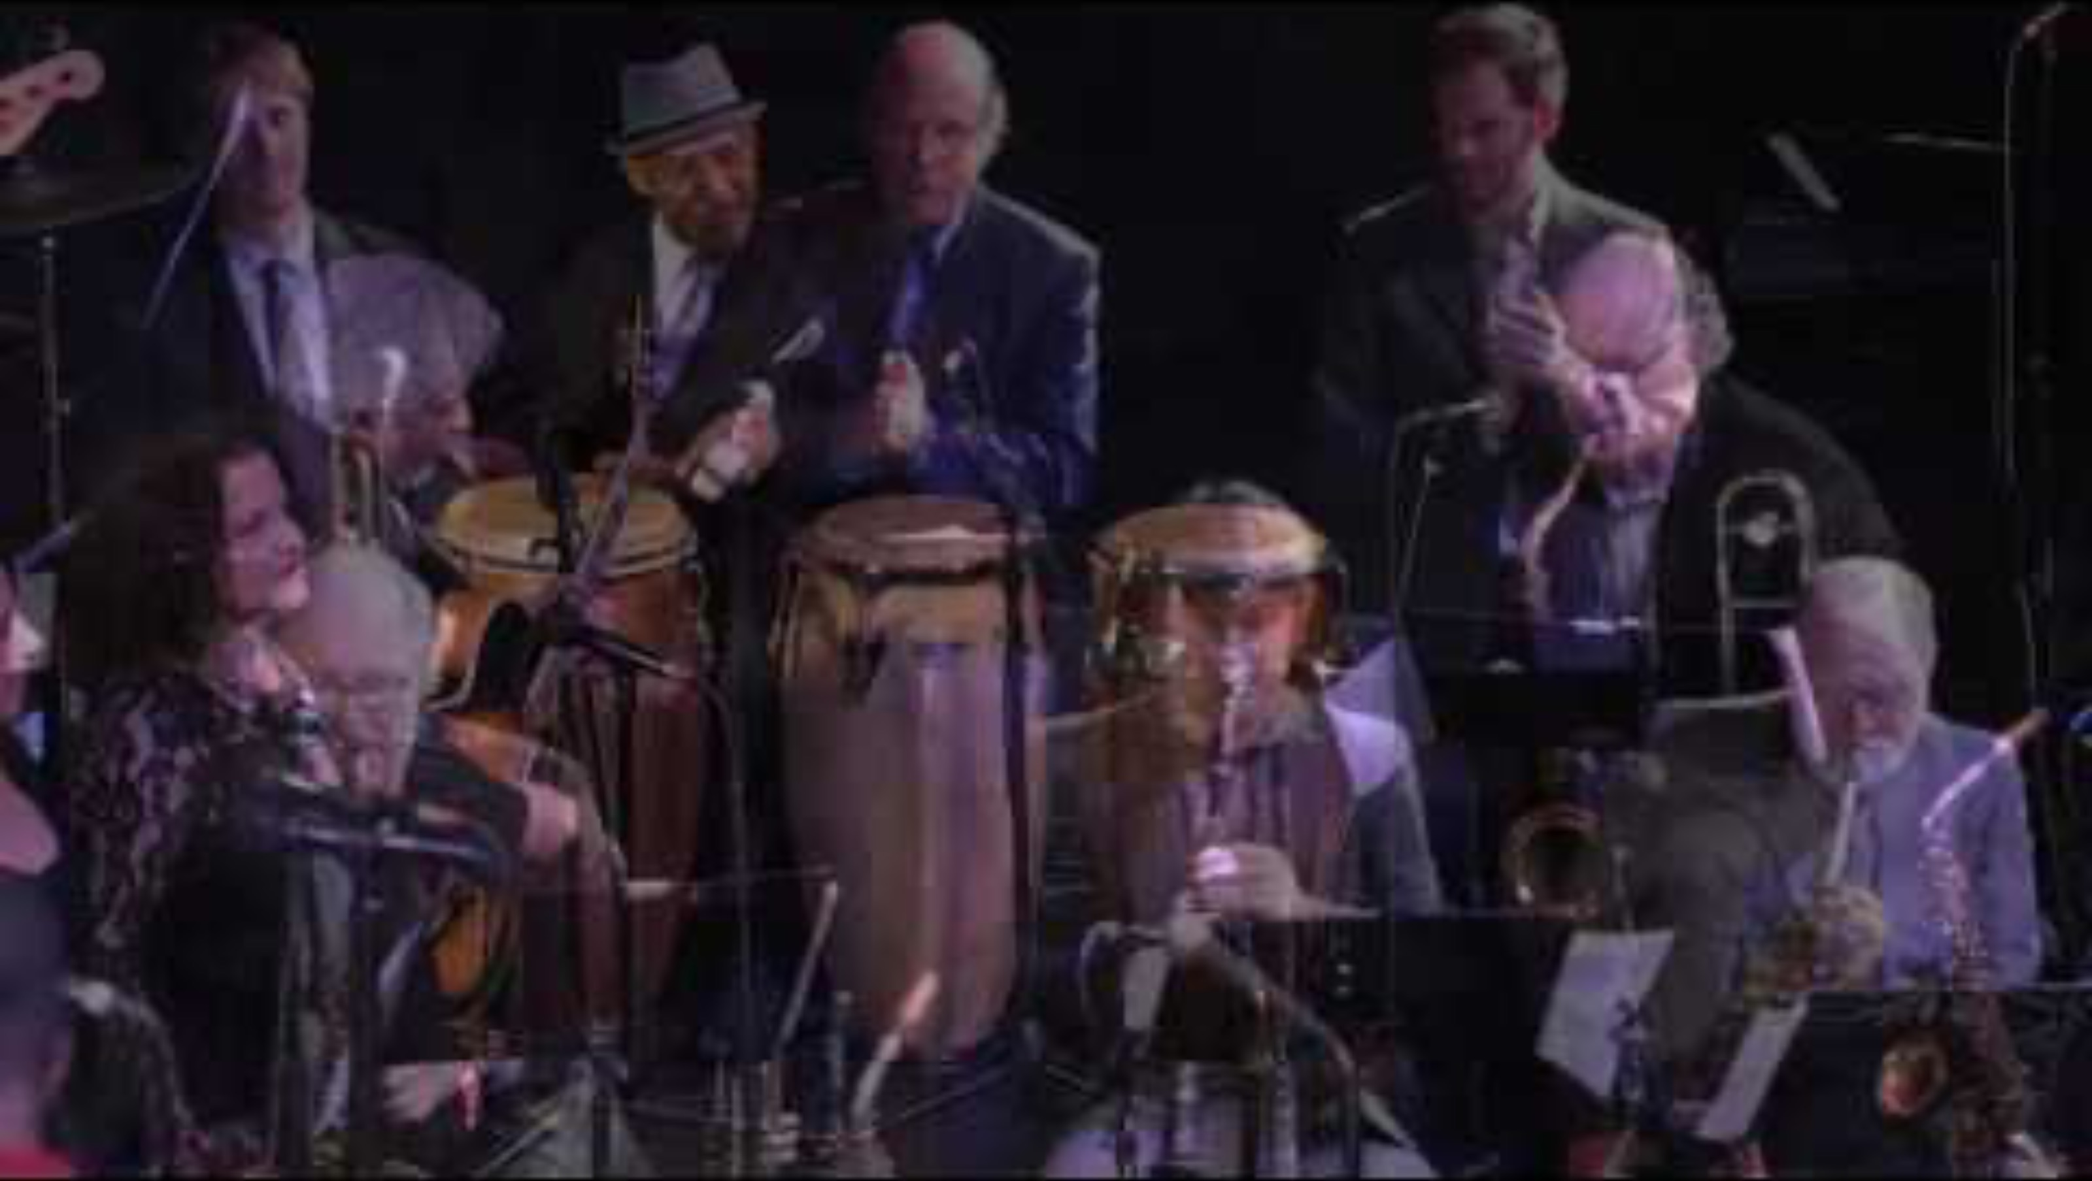
Adarech Arada
From Armenia to Addis Ababa: a Tribute to Nerses Nalbandian.
February 19, 2017, Mosesian Center for the Arts, Watertown Massachusetts.

Slide 26

https://www.facebook.com/Tizta1916/videos/musse-nersis-nalbandian/638709766460924/

Slide 27
Melodic structure: pentatonic scales which give it a distinctive sound different from Western Music.
Rhythmic complexity: the rhythms incorporate polyrhythms and syncopation reflecting traditional Ethiopian dance music, often using 6/8- and 4/4-time signatures.
Instrumentation: local instruments alongside Western instruments.
Improvisation, allows musicians to express individuality and creativity.
Cultural fusion: funk, soul, traditional Ethiopian folk music, and also afro-funk.
KEY CHARACTERISTICS

Slide 28
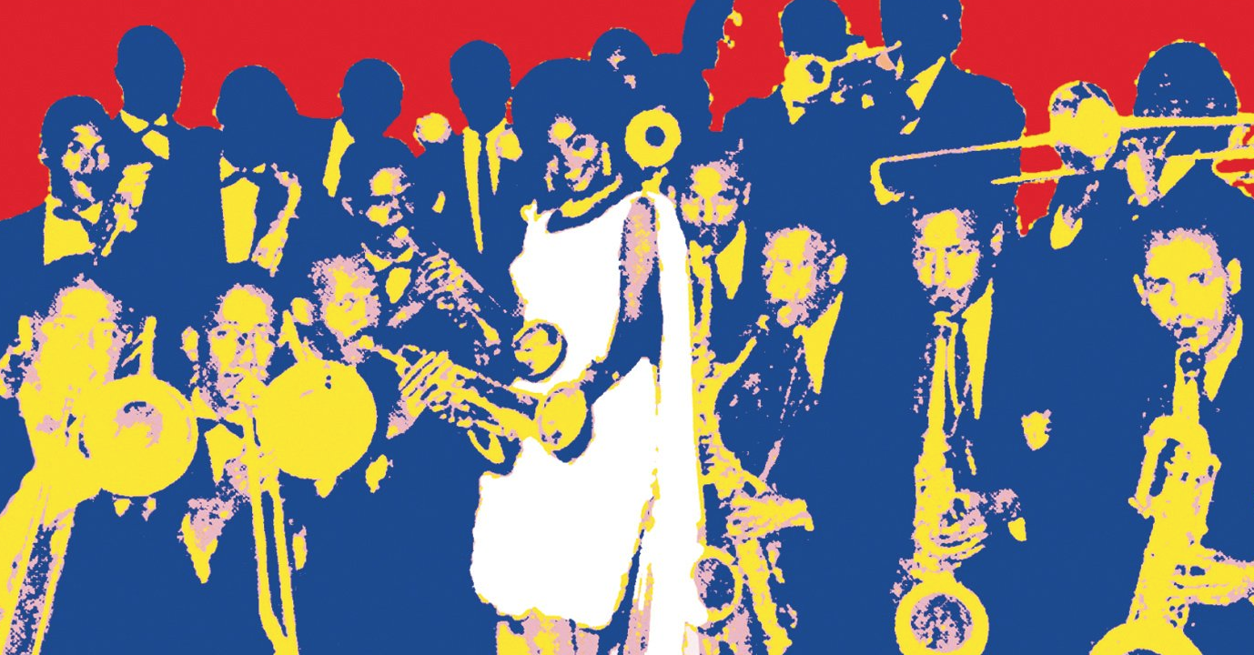
ETHIOPIAN SWING ERA (1960-1974)

Slide 29
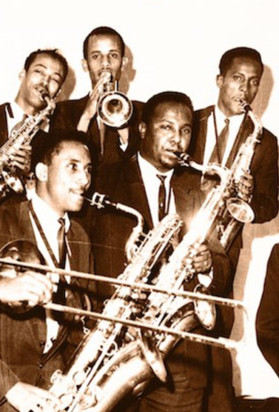
Ethiopia's exposure to Western music
The boom in the popularity of jazz
U.S. military and diplomatic presence
Emperor Haile Sellasie had made many liberal changes
Emergence of Ethiopian jazz bands in Addis Ababa
Country’s golden age of music and creativity

Slide 30
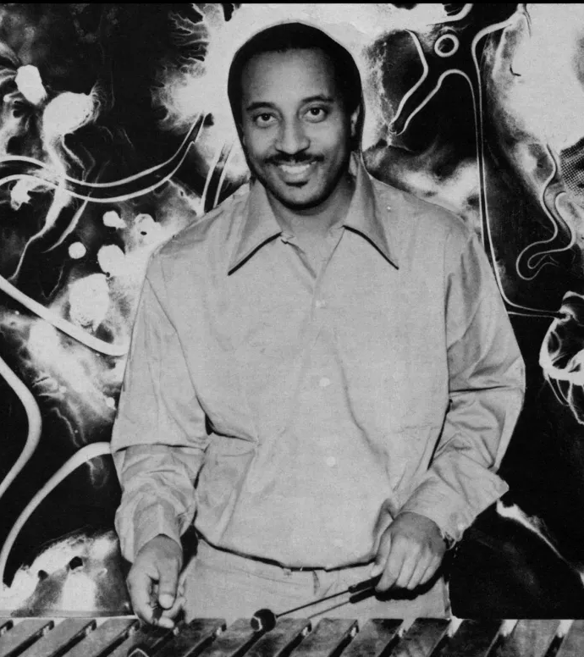
Mulatu astatke
ሙላቱ አስታጥቄ
(1943)
The father of Ethio-jazz.
Astatke combined Ethiopian music with Western jazz and rhythms.
He studied jazz at Berklee College of Music in Boston in 1958.

Slide 31

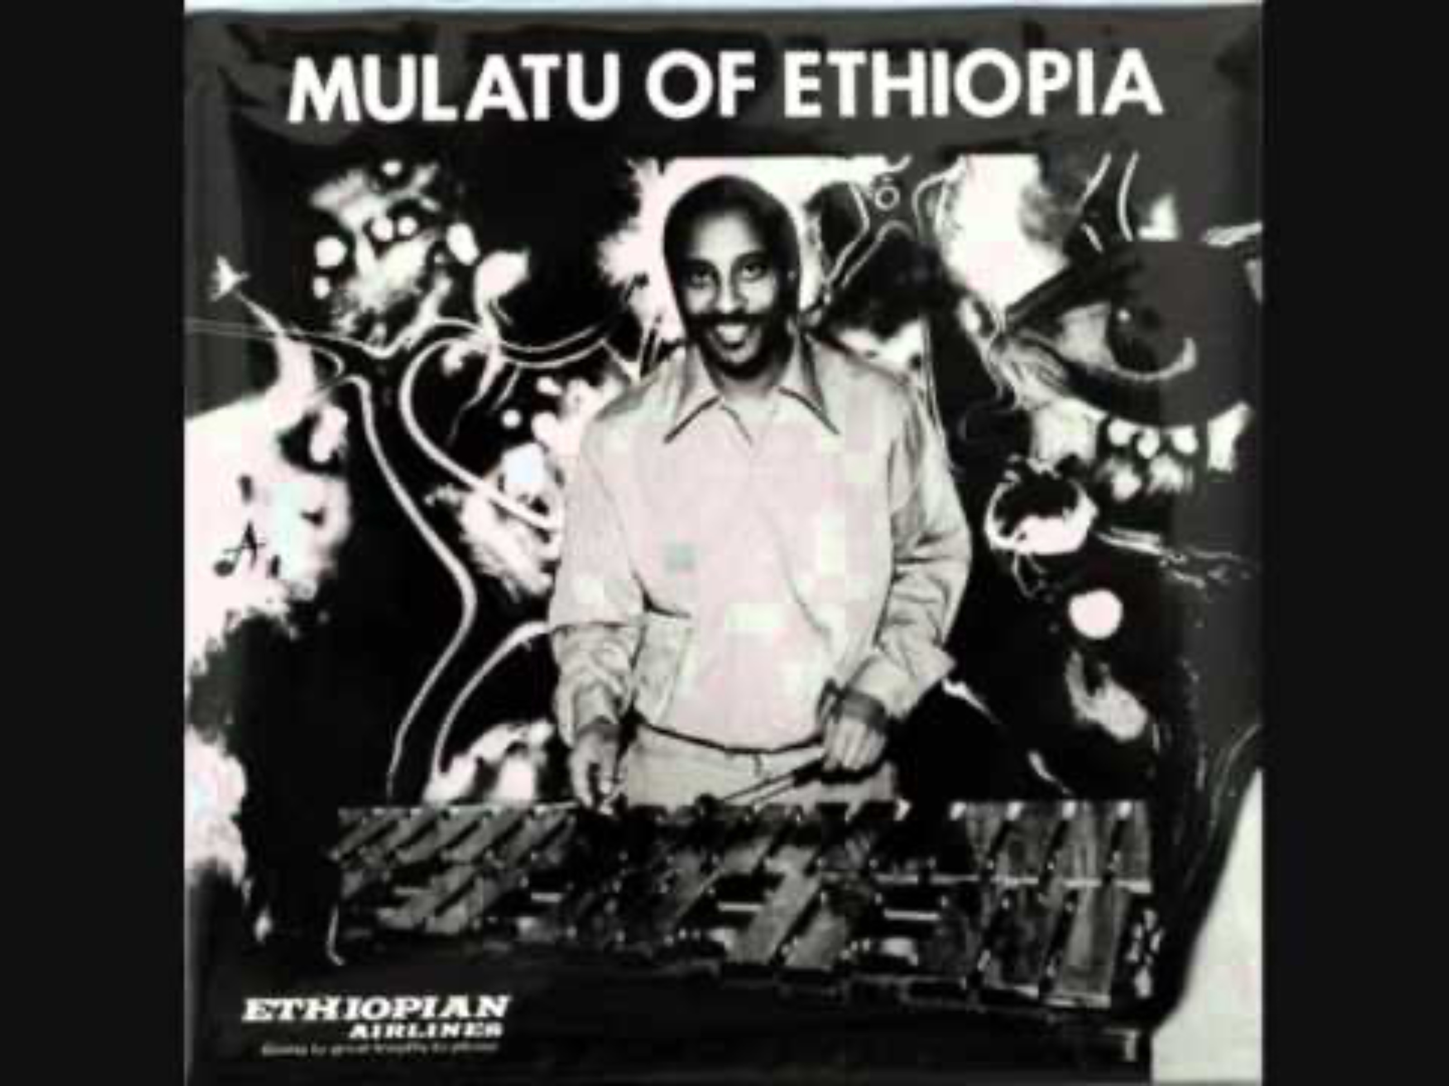
A Kiss Before Dawn
Chifara

Slide 32
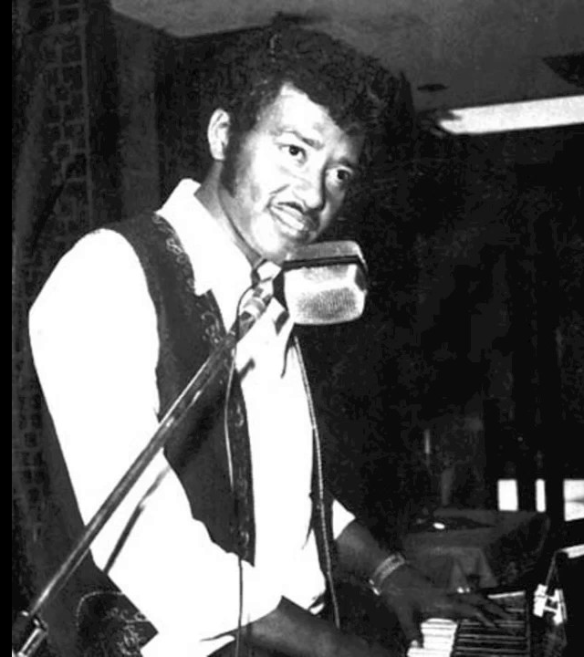
ALEMAYEHu ESHETE ዓለማየሁ እሸቴ
(June 1941 – 2 September 2021)
Ethiopian singer, widely known as the "Abyssinian Elvis" for his dynamic performances and his fusion of traditional Ethiopian music with Western rock and roll influences.

Slide 33
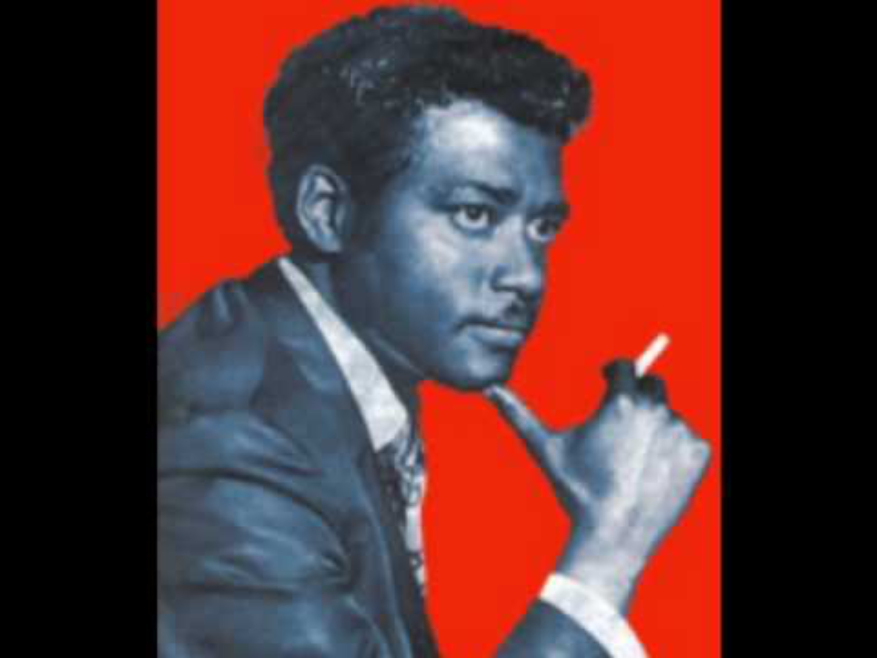
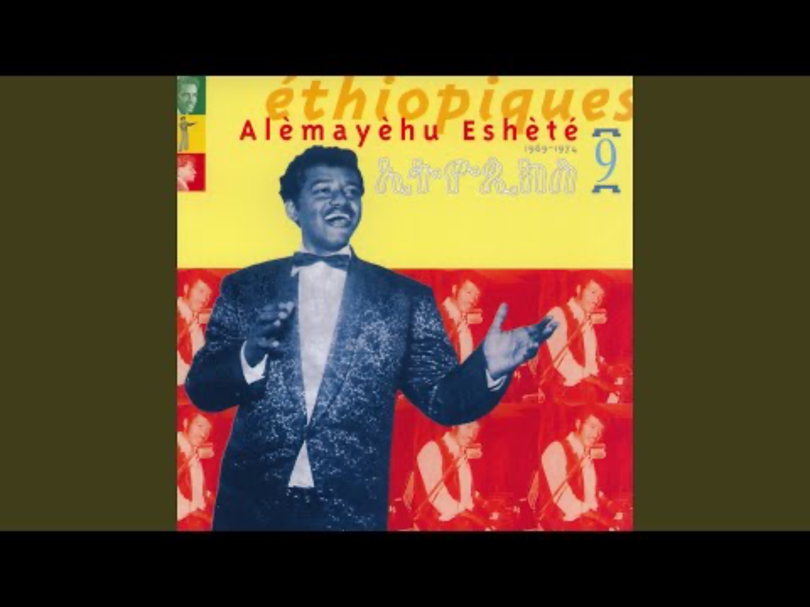
Temar Lije
Timarkyalesh

Slide 34
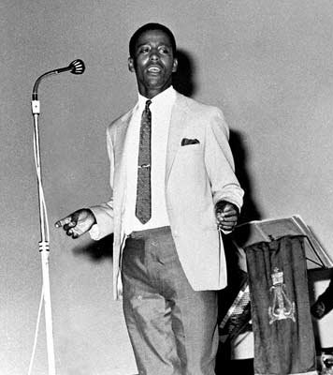
MAHMOUD AHMED
ማሕሙድ አሕመድ
(8 May 1941 -)
Ethiopian singer.
He had great popularity in Ethiopia in the 1970s and among the Ethiopian diaspora in the 1980s.

Slide 35
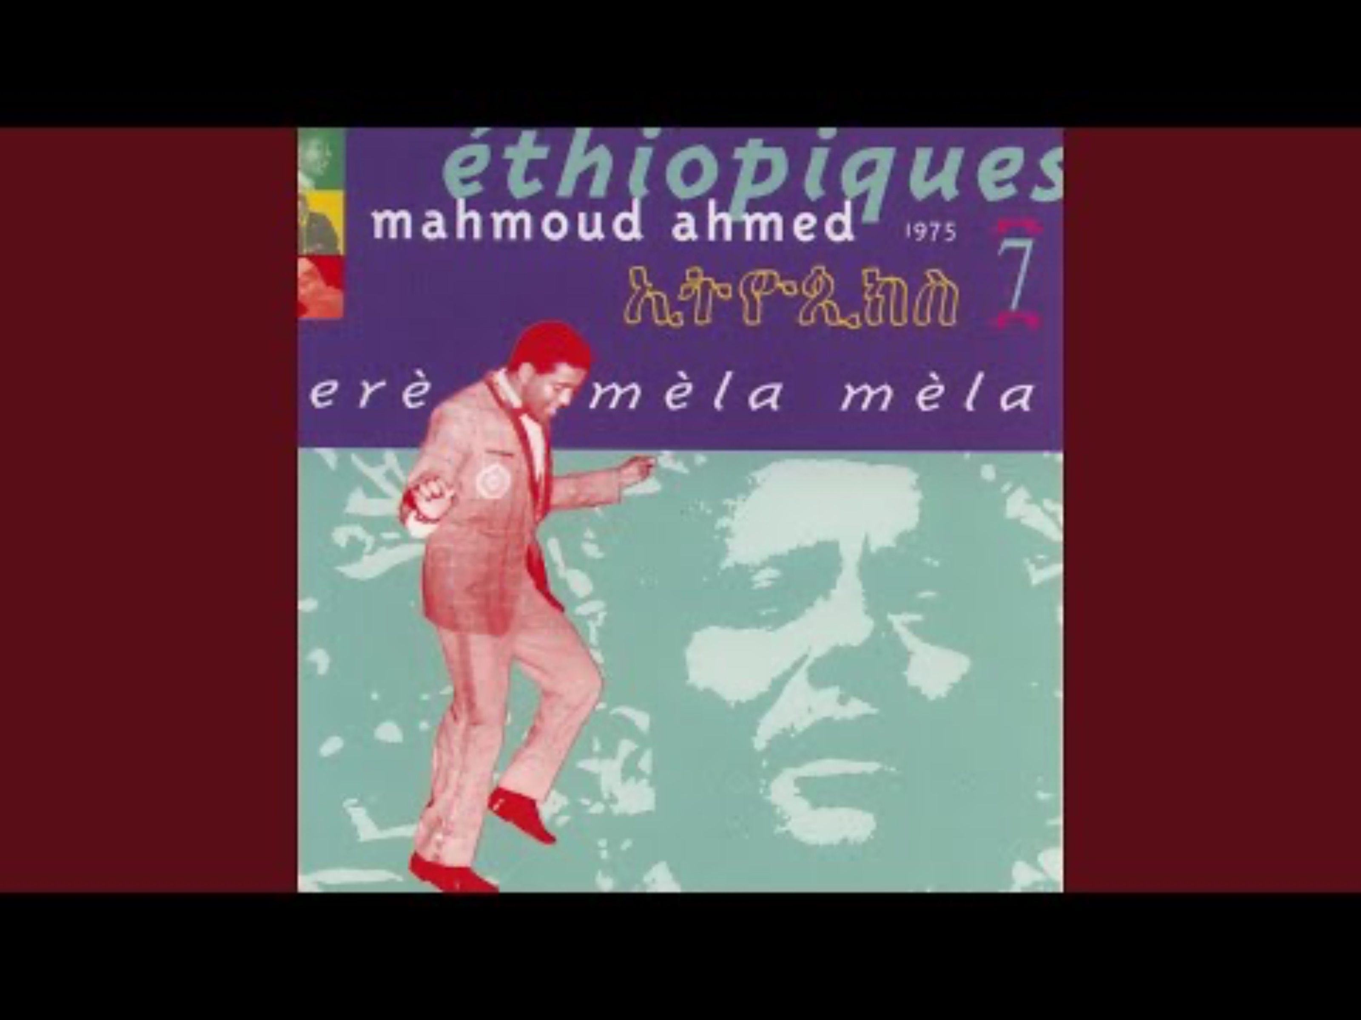
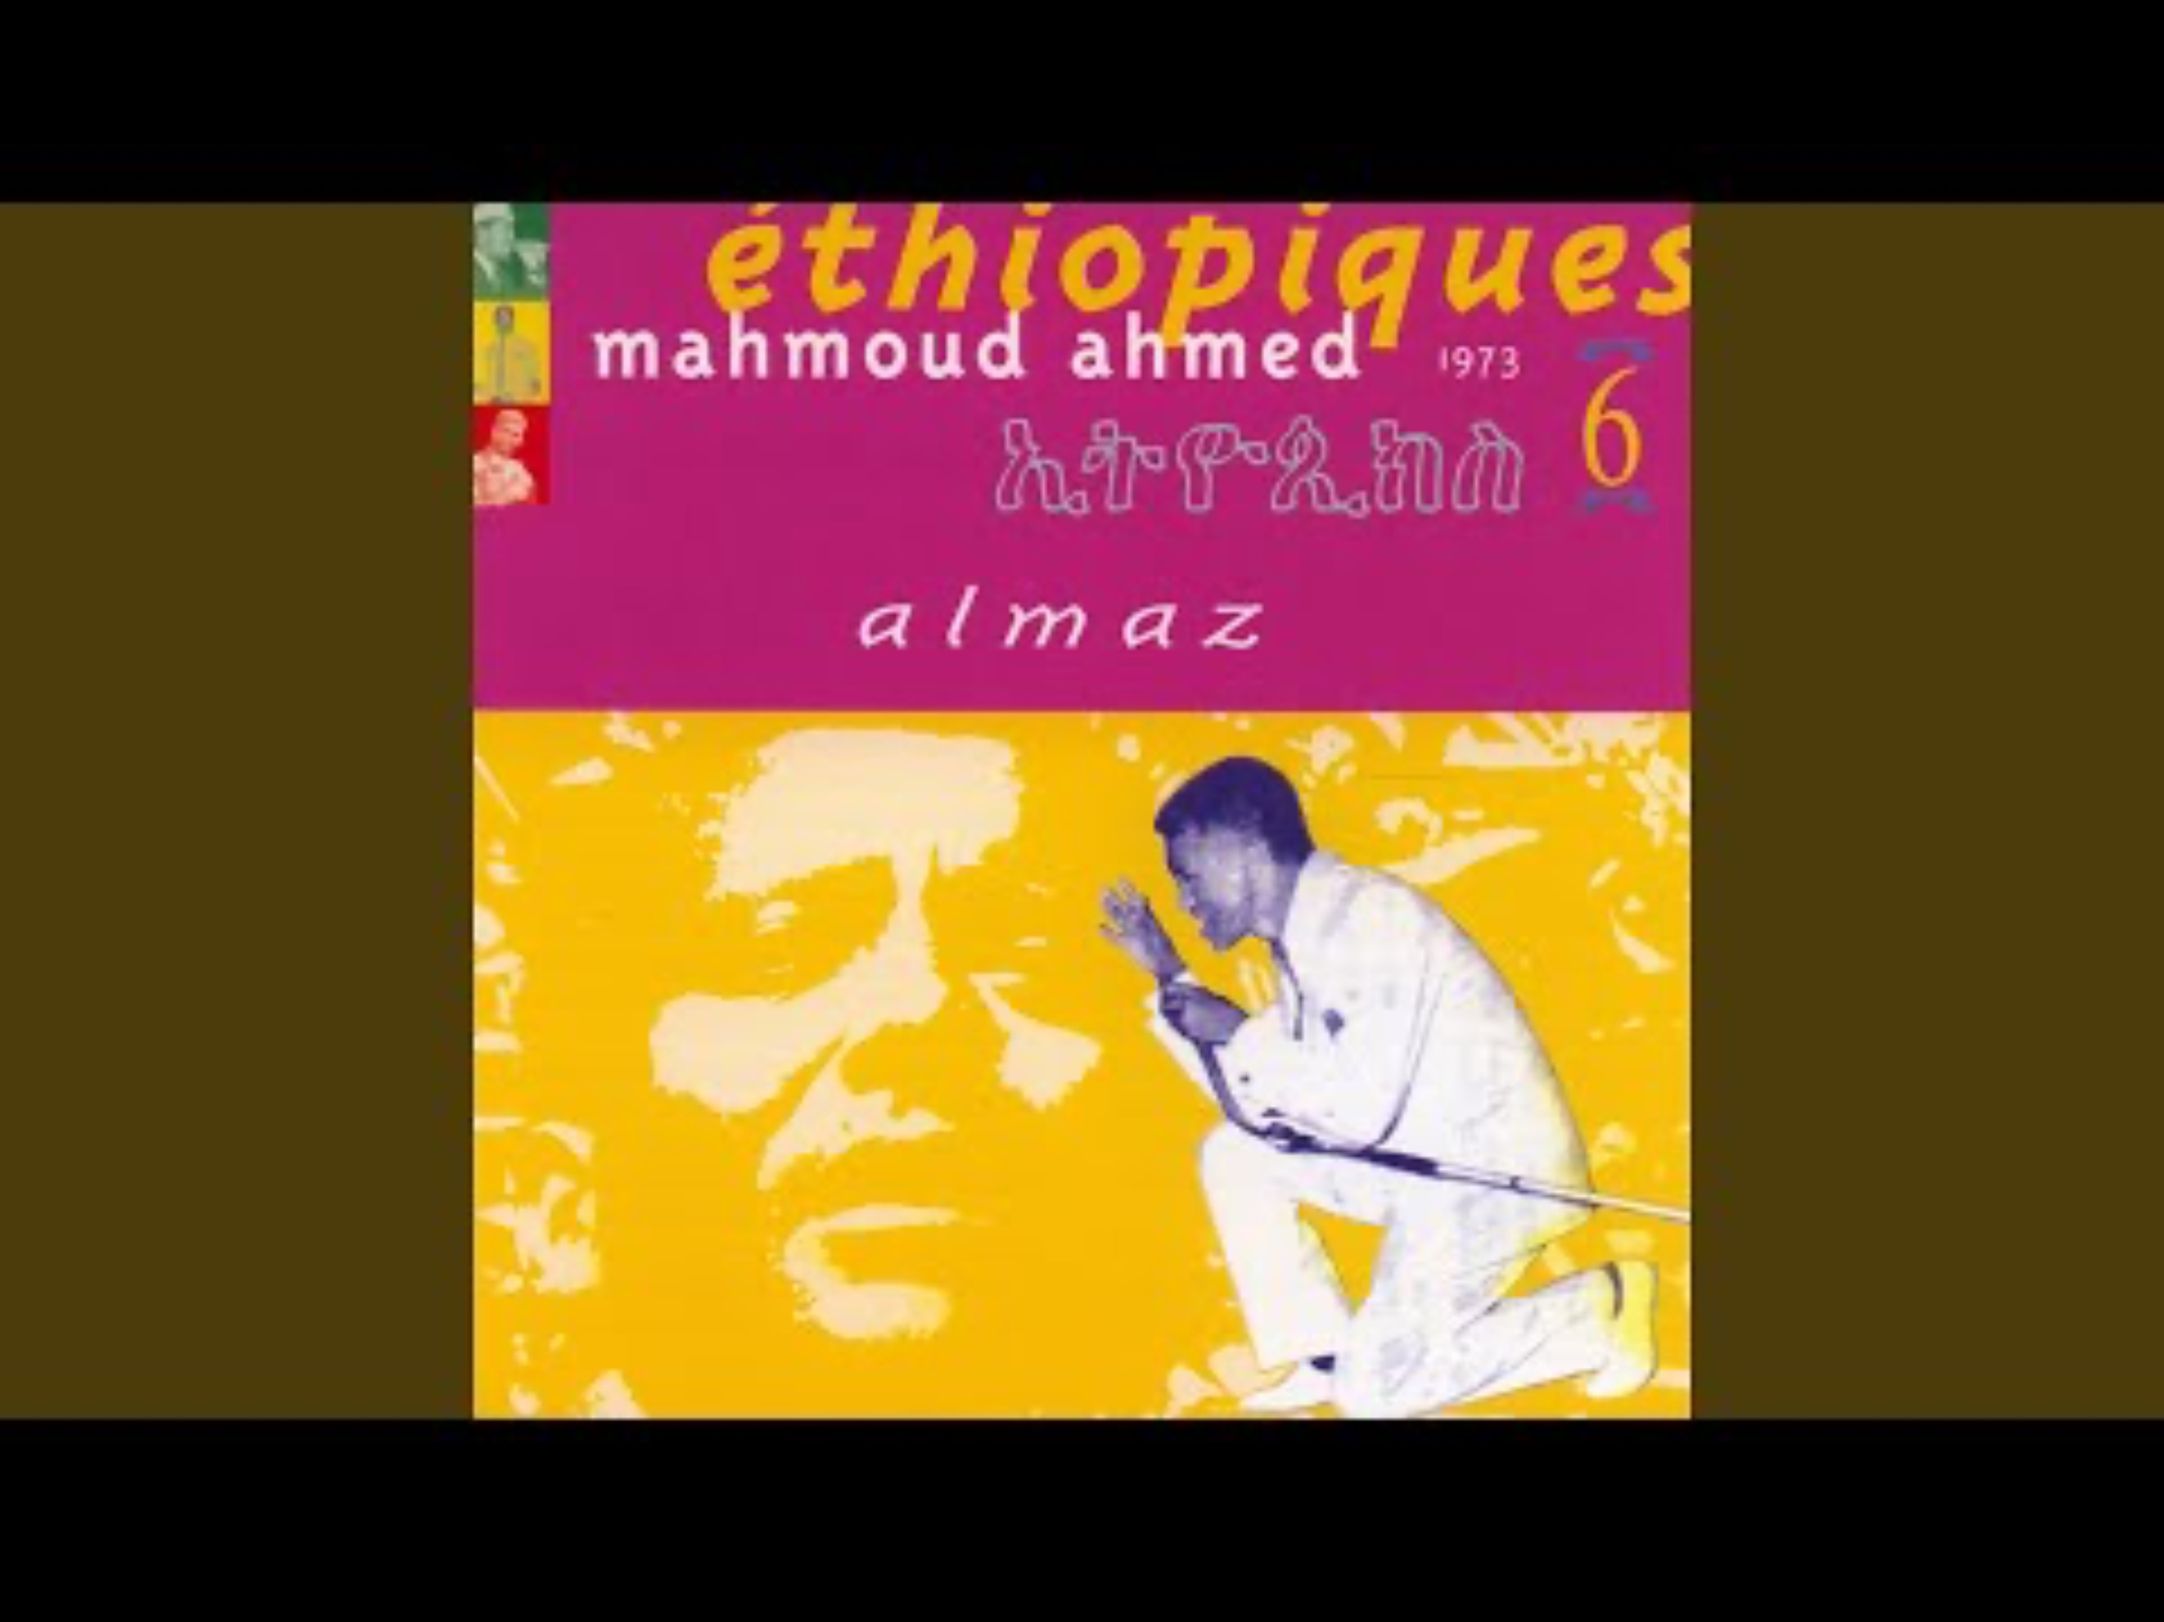
Notes:
Kulun mankwalesh

Slide 36
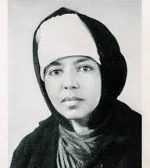
EMAHOY TSEGUÉ- MARYAM
ጽጌማርያም
(12 December 1923 – 26 March 2023)
Ethiopian composer, pianist, and nun.
In 1933, she became a civil servant and singer to Emperor Haile Sellasie.
Her first record was released in Germany, in 1967.

Slide 37
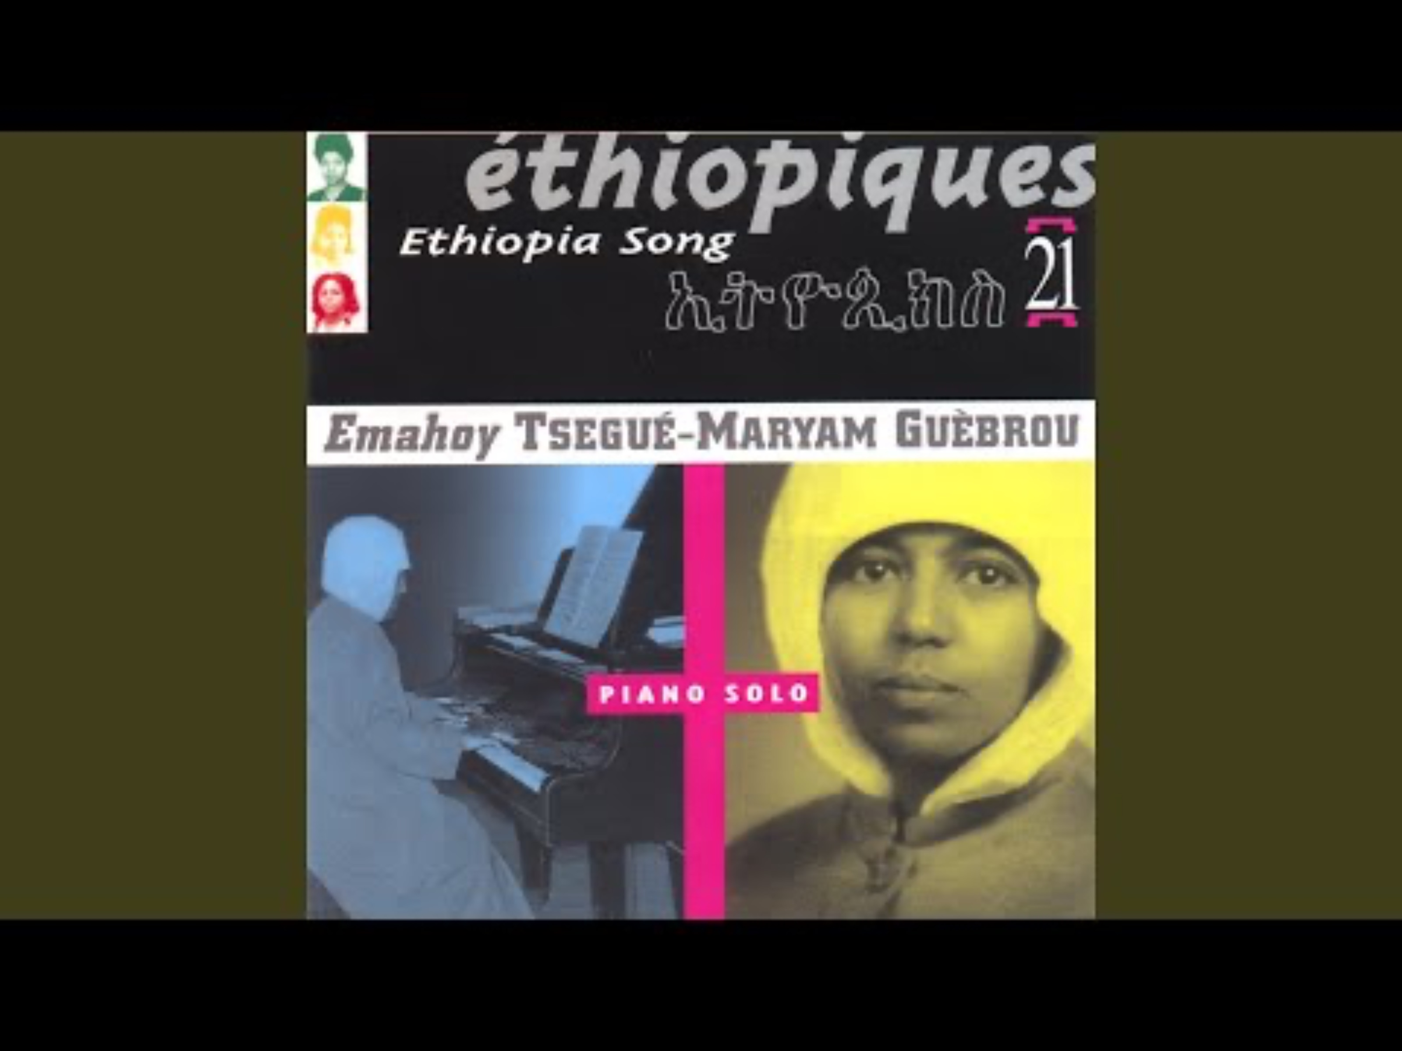
The Homeless Wanderer

Slide 38
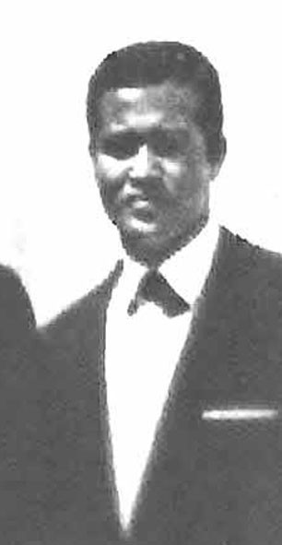
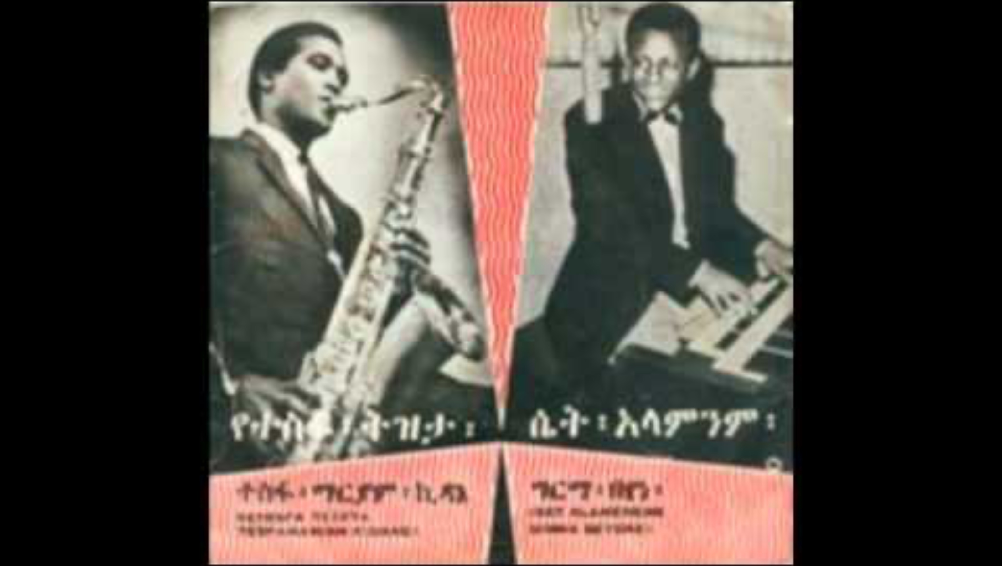
Tèsfa-Maryam
Eritrean saxophonist, influenced by the American radio programmes broadcast from the US base in Asmara.
He played in the the Police Orchestra in Asmara and Ras Band & The All Star Band.

Slide 39

HAILU MERGIA
ኃይሉ መርጊያ
(1946 - )
Ethiopian keyboardist, accordionist, composer, and arranger.
He moved to Washington, DC, where he has worked as a taxi driver alongside his musical career.

Slide 40
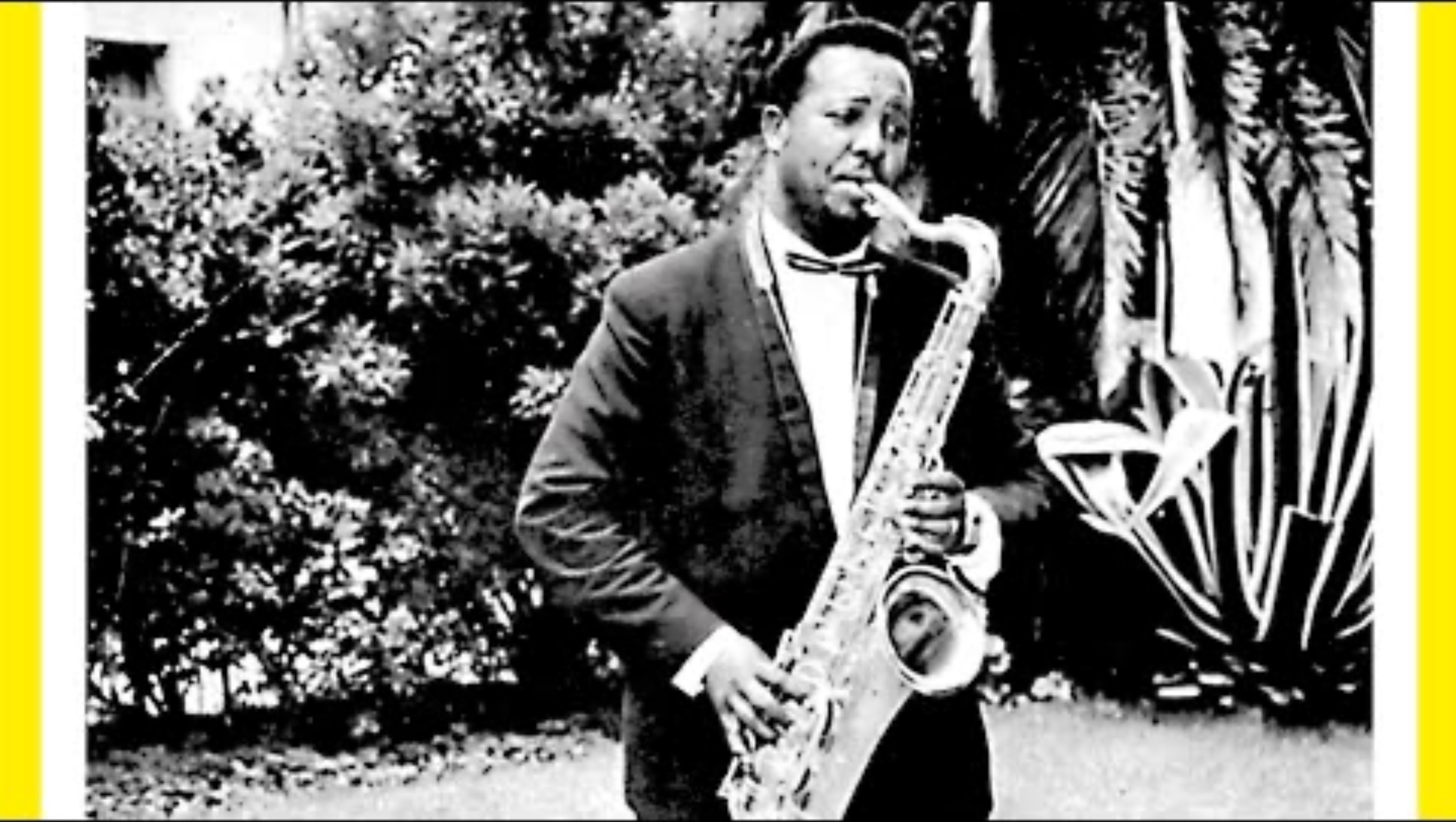
GETATCHEW MEKURYA
ጌታቸው መኩሪያ
(14 March 1935 – 4 April 2016)
Ethiopian jazz saxophonist.
He started his career at the Addis Ababa City Band and went on to play alongside many of Ethiopia’s biggest orchestras .
His famous album: Negus of Ethiopian Sax.

Slide 41
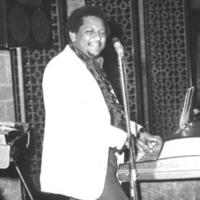
GIRMA BEYENE
ግርማ በየነ
Bornin Addis Ababa, is an Ethiopian lyricist, composer, arranger, vocalist, and pianist, most active during the golden era of Ethiopian vinyl records (1969–78).
Girma left Ethiopia during the Derg military dictatorship to live in the United States.

Slide 42
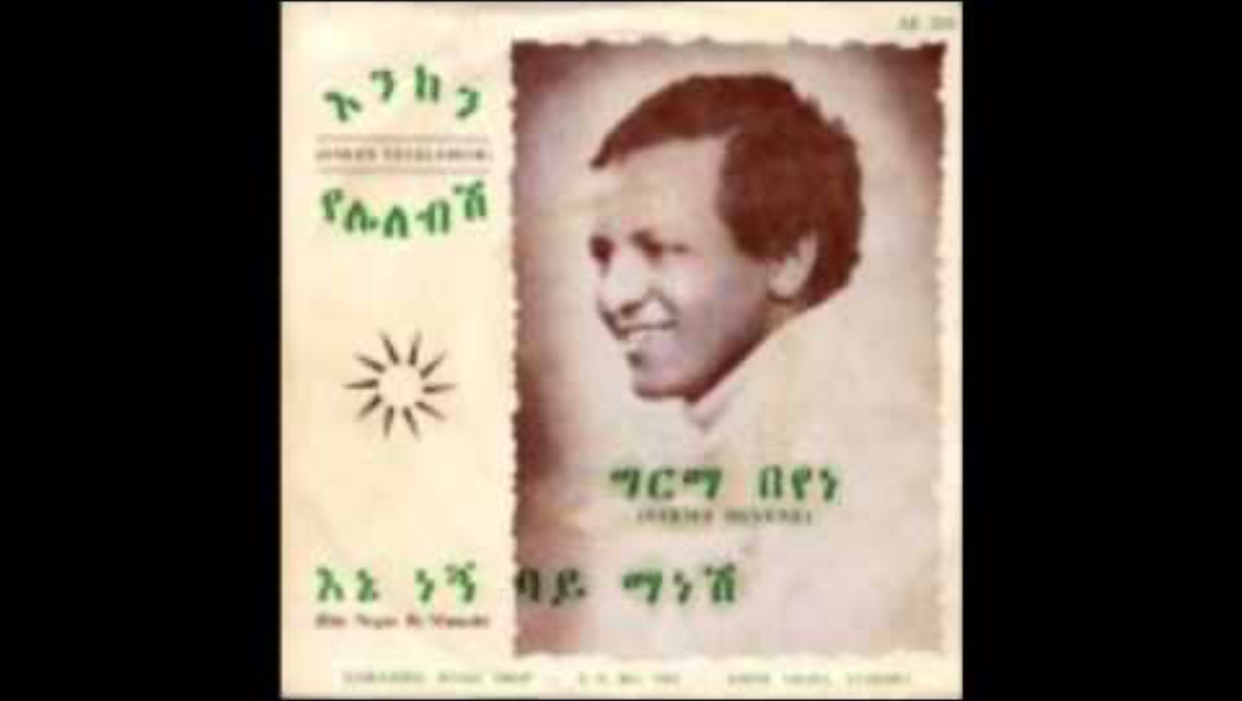

Slide 43
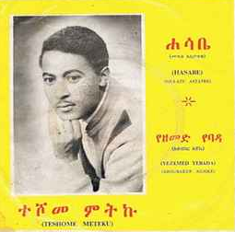
TESHOME METEKU
ተሾመ ምትኩ
(1949-)
He started his career in the 1960s during the country's musical Golden Age.

Slide 44


Slide 45
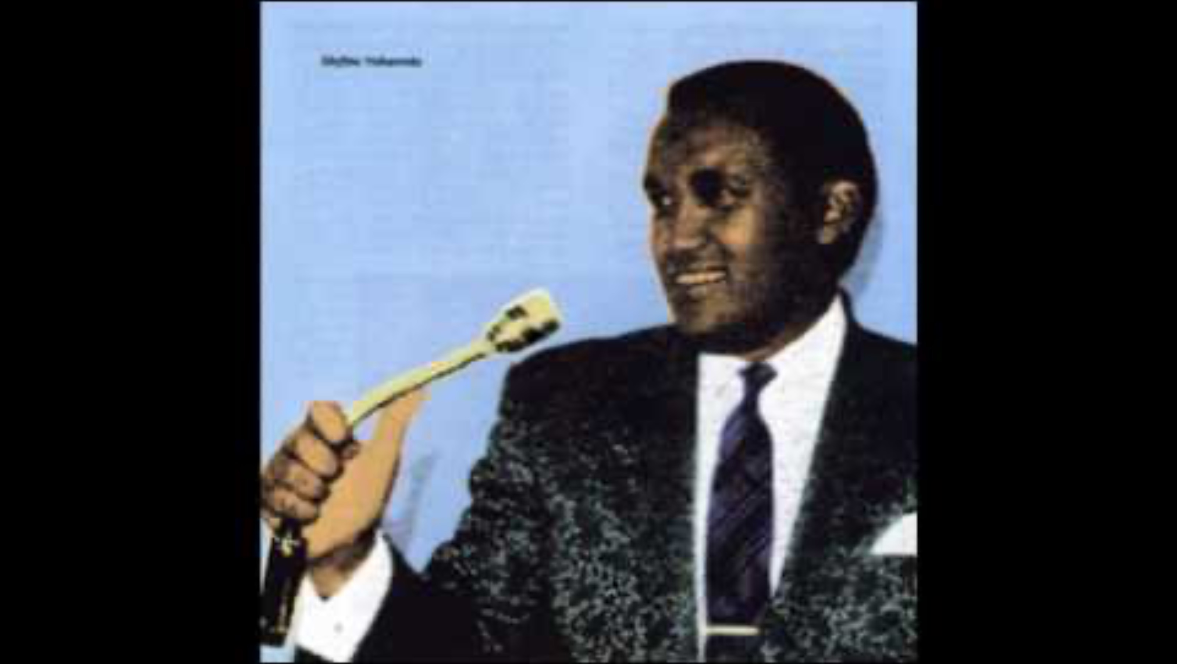
SEIFU YOHANNES
(1946-1972)
Ethiopian singer

Slide 46
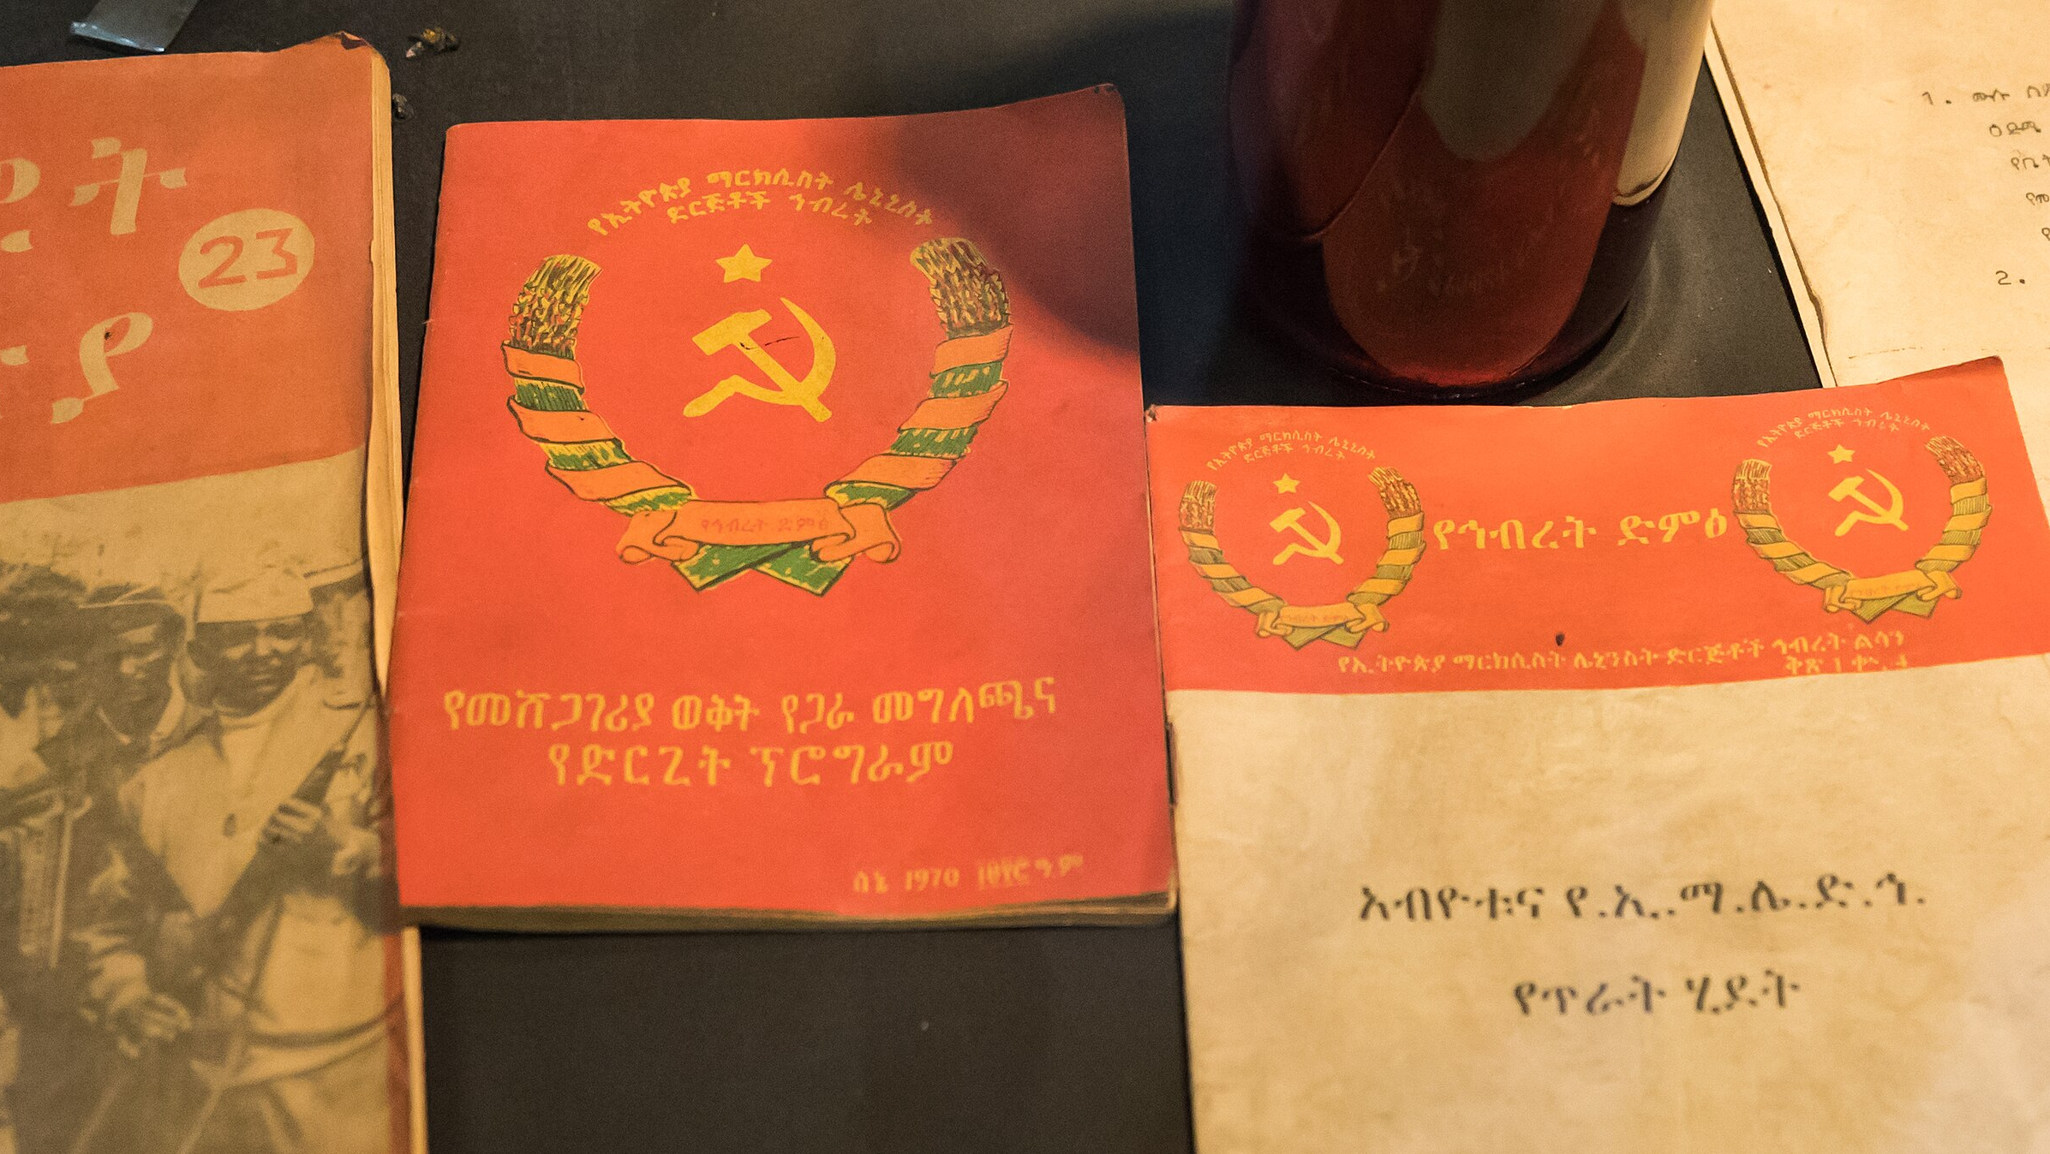
THE DERG PERIOD
The Marxist regime of Mengistu Haile Mara which rose to power in 1974, influenced Ethiopia’s musical scene and liberal social life.
As a result, many musicians fled the country or kept a low profile, and a generation grew up with hardly any memory of Ethio-jazz.

Slide 47
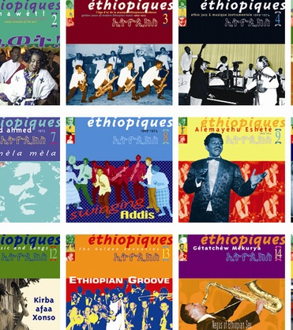
THE REVIVAL
In 1997, Francis Falceto, a French music producer and promoter, was fascinated by Ethiopian music.
23-volume series called Ethiopiques on the French label Buda Musique (the series has since evolved to 28 compact discs).

Slide 48
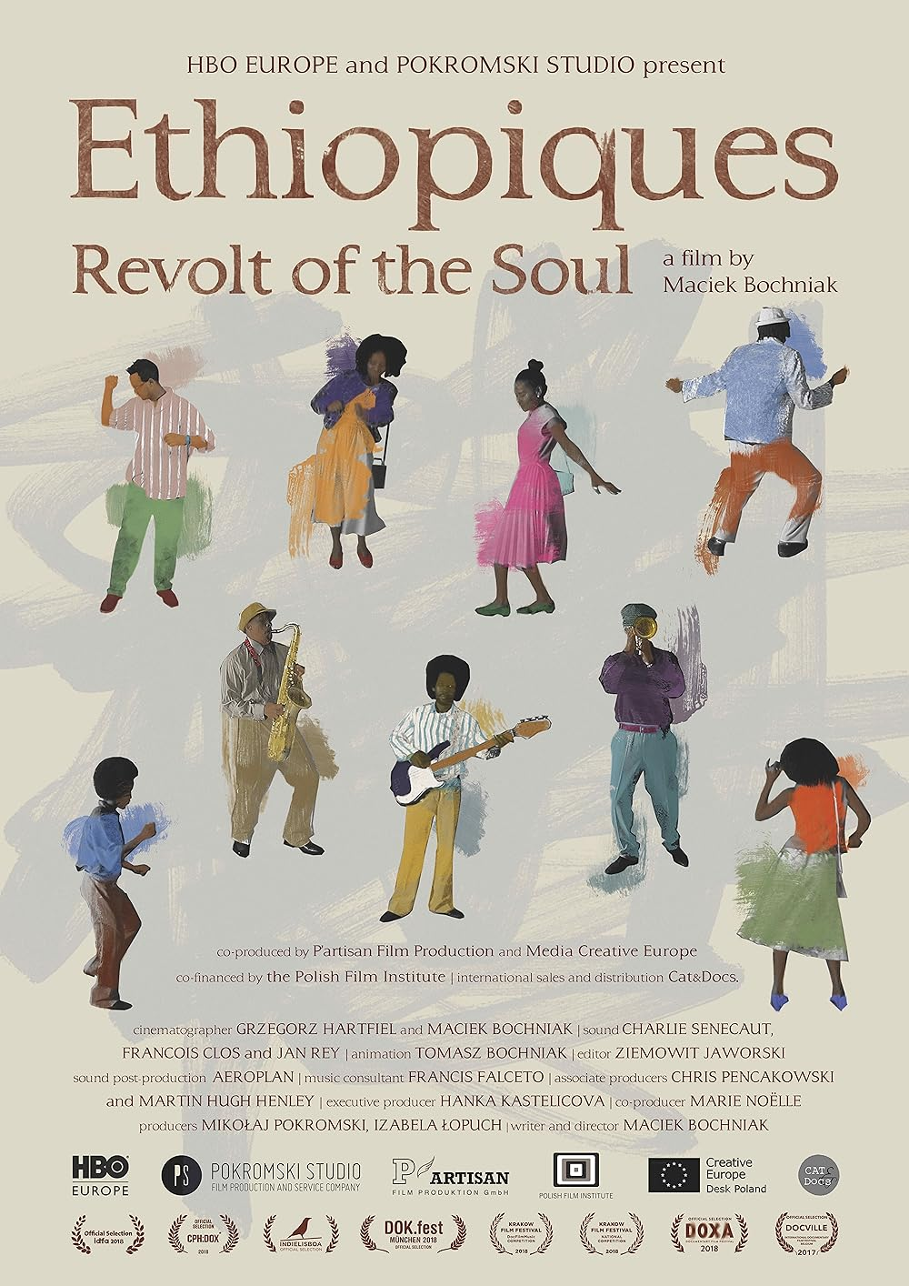
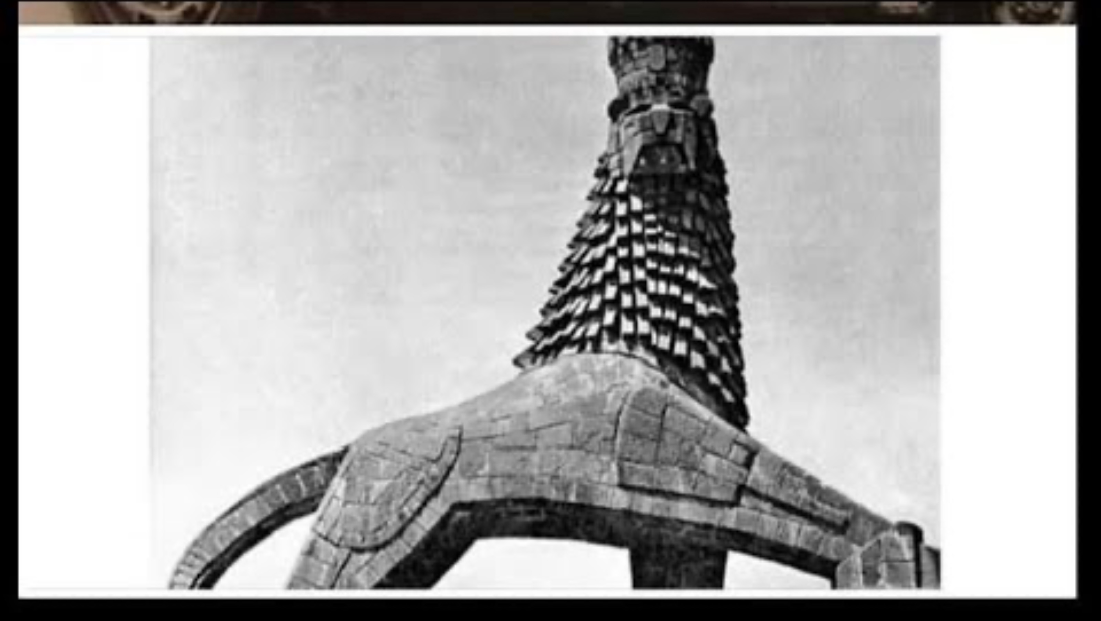

Slide 49
Ethiopia’s music colleges teach the history of Ethio-jazz as part of their curricula, and a new generation of Ethio-jazz musicians has emerged.
Ethiopian jazz

Slide 50
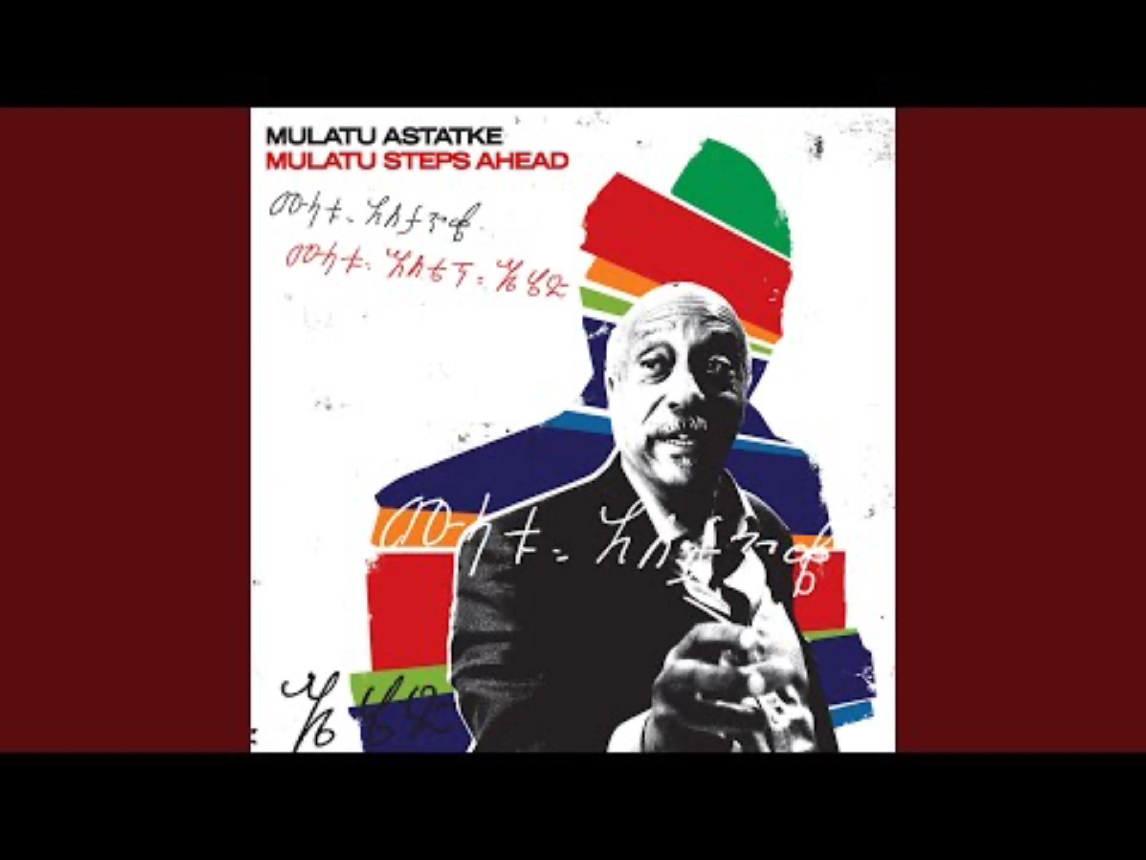
THANK YOU
በጣም እናመሰግናለን!
‘As musicians we have to look to the past, go to the origin because we will always find something interesting there’.
Mulatu Astatke

